Slide 1
How Social is Your Media? –Technology and Public Employment
40th Annual Local Government Law in Florida
May 12-13, 2017
Gregory A. Hearing
ghearing@tsghlaw.com
Thompson, Sizemore, Gonzalez & Hearing, P.A.
Tampa, Florida
(813) 273-0050

Slide 2
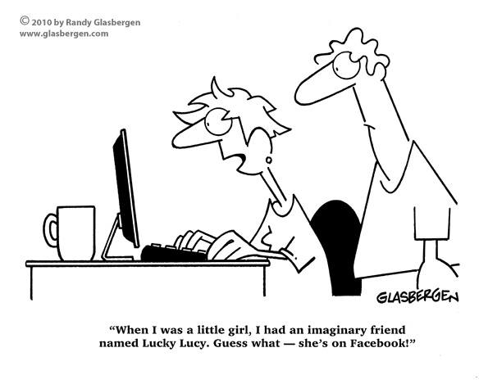

Slide 3
Social Media Today
Accessing social media is a daily ritual for most employees.
A 2013 survey by the Ethics Resource Center shows:
72% of workers access social media on the job at least one time each day, a majority of which access social media several times per day.
28% of employees spend at least an hour on social networking sites each day.
New social media decisions come out daily.

Slide 4
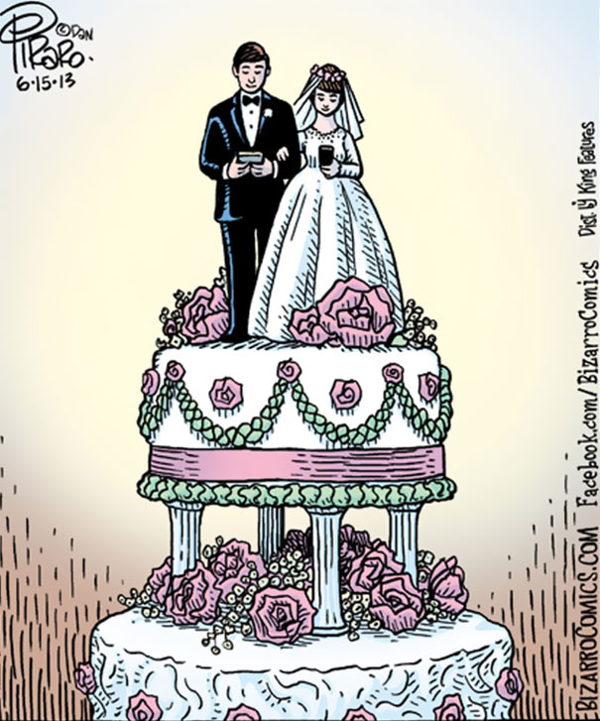
Today’s Topics
Social Media in Workplace Investigations;
Social Media and Harassment/Retaliation/Discrimination;
Social Media and Florida’s Public Employees
Relations Act;
Social Media and First/Fourth Amendment
Protections;
Social Media and the ECPA/SCA;
Discovery and Social Media;
Social Media in Ongoing Litigation.

Slide 5
Social Media in Workplace Investigations
Review of social media in workplace investigations is common.
This practice, however, presents both benefits and risks.
Reviewing social media accounts may provide pertinent information.
Employers generally may rely on publicly-available information posted by the applicant on a social media website.
However, social media websites may be inaccurate.

Slide 6
Social Media in Workplace Investigations
Case Illustrations:
Lineberry v. Detroit Medical Ctr., No. 11-13752, 2013 WL 438689 (E.D. Mich. Feb. 5, 2013) (finding that the employer had an honest suspicion of FMLA fraud where the employee admitted to lying after being confronted with Facebook photos of the employee on vacation in Mexico);
Jaszczyszyn v. Advantage Health Physician Network, 504 F.App’x 440 (6th Cir. 2012) (upholding the termination of a plaintiff on intermittent FMLA who posted pictures of herself attending a Polish heritage festival where she spent eight hours socializing with friends and, after several of Plaintiff’s coworkers saw the pictures, was reported to her supervisor, who investigated the same).

Slide 7
Social Media in Workplace Investigations
Yet, accessing information through social media may expose employers to risk by discovering legally protected characteristics.
When conducting social media investigations, it is important for employers to retain search results, particularly where any adverse employment action is taken based on social media activity.
Case illustration: Butler v. Edwards-Brown, No. 13-1378, 2014 WL 1776035 (E.D. Mich. May 5, 2014) (denying employer’s summary judgment, in part. due to the absence of the exact text that the plaintiff posted on her Facebook account and upon which the defendants relied in denying the plaintiff work assignments).

Slide 8
Social Media in Workplace Investigations
Numerous states have sought to curb employers’ access to employees’ and applicants’ social media accounts:
26 states now restrict employers’ abilities to demand that employees and/or applicants disclose means for accessing their personal social media accounts (i.e., user names and passwords).
States began enacting these laws in 2012 and, in 2016 alone, fifteen states considered enacting them (legislation enacted in Illinois, Nebraska, Virginia, and West Virginia).
Florida Senate Bill 186 - Social Media Privacy: proposed in 2015, but died in committee in March 2016.

Slide 9
Social Media in Workplace Investigations
These statutes provide a variety of protection to employees:
As for applicant screening, many of them prohibit employers from requesting log-in credentials, permission to view social media accounts, and privacy setting changes;
With respect to workplace investigations, some of the statutes provide limited exceptions for such investigations, while others do not:
Nevada does not provide any exception for workplace investigations that might require access to an employee’s personal social media accounts;
California, Oregon, and Washington provide exceptions to investigations of legal violations and alleged misconduct, allowing employers to ask employees to provide social media account content relating to alleged misconduct
Still, Arkansas permits an employer to request any employee’s social media login credential to investigate workplace misconduct.
Notably, almost all of the state statues exempt both employer provided devices and accounts from protection.

Slide 10
Today’s Topics
Social Media in Workplace Investigations;
Social Media and Harassment/Retaliation/Discrimination;
Social Media and Florida’s Public Employees
Relations Act;
Social Media and First/Fourth Amendment
Protections;
Social Media and the ECPA/SCA;
Discovery and Social Media;
Social Media in Ongoing Litigation.

Slide 11
Social Media and Harassment/Retaliation/Discrimination
The workplace is no longer limited to a nine-to-five schedule due to electronic devices.
Added connectivity creates opportunities for harassment and often blurs boundaries of appropriate conduct.
Governmental agencies and courts have viewed harassment via social media and digital devices in the same manner as they view face-to-face harassment.
For example: It was noted during a January 14, 2015, EEOC press release that workplace harassment is alleged in roughly 30 percent of all EEOC charges and that the ease of posting and responding to messages and images through social media has spawned employee complaints of harassment.

Slide 12
Social Media and Harassment/Retaliation/Discrimination
Recent cases highlight the seriousness of employee harassment through social media:
Medlin v. Am. Airlines , E.D. Pa., No. 2:16-cv-05708 (Complaint filed 11/1/16) (female flight attendant filed harassment lawsuit alleging that male flight attendants harassed her via Facebook, including by calling her a “sow,” and that American Airlines failed to enforce its social media policy).
Hannah v. Northeastern State Univ., 2015 WL 501933 (E.D. Okla. Feb. 5, 2015) (denying summary judgment on the plaintiff’s (a professor) hostile work environment claim based on racist Facebook posts by two professors, including comments lamenting that a “f*cking indian” was made department chair).
Espinoza v. County of Orange, No. G043067, 2012 WL 420149 (Cal. App. 2012) (upholding a $1.6 million verdict against an employer where the plaintiff was harassed by co-workers on a blog and the employee reported the harassment to his supervisor but it was not addressed).
In August 2012, the EEOC reached a $2.3 million settlement with national retailer Fry’s Electronics in a case involving an assistant store manager sending frequent sexually charged text messages to a twenty-year-old sales associate.

Slide 13
Social Media and Harassment/Retaliation/Discrimination
Other examples:
Amira-Jabbar v. Travel Services, Inc., 726 F.Supp.2d 77 (D. P.R. 2010):
The plaintiff sued her former employer for race discrimination based on racially derogatory comments posted by a co-worker on Facebook. The comments were contained in the caption of a photo displayed on the co-worker’s Facebook page showing the plaintiff and other co-workers at a work function.
The plaintiff argued that her employer was liable for the comment because it allowed employees to post comments and photos on social networking sites during company time and for company purposes.
The court dismissed the harassment claim as not sufficiently severe and/or pervasive to create a hostile work environment and because the employer promptly investigated the plaintiff’s complaint and took prompt, effective remedial action (including the blocking of employee access to the various social media platforms).
This case raises the issue of whether employee access to social media platforms during work hours or for work purposes will cause or contribute to employer liability.

Slide 14
Social Media and Harassment/Retaliation/Discrimination
Other examples:
Stewart v. CUS Nashville, LLC, No. 3:11-CV-0342, 2013 WL 456482, at *11 (M.D. Tenn. Feb. 6, 2013) (finding that a manager’s social media posts concerning a terminated employee could be relied on to find the employer liable for retaliation).

Slide 15
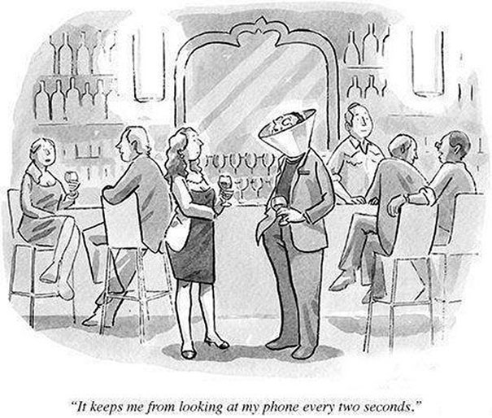
Today’s Topics
Social Media in Workplace Investigations;
Social Media and Harassment/Retaliation/Discrimination;
Social Media and Florida’s Public Employees
Relations Act;
Social Media and First/Fourth Amendment
Protections;
Social Media and the ECPA/SCA;
Discovery and Social Media;
Social Media in Ongoing Litigation.

Slide 16
Social Media and Florida’s Public Employees Relations Act
Many recent social media cases involve issues relating to protected concerted activities under the National Labor Relations Act; however, social media utterances may have some level of protection under the Public Employees Relations Act, Chapter 447, Part II, Florida Statutes (“PERA”).
In general, the Florida Public Relations Commission follows the well-known Pasco County test (Pasco County. Sch. Bd. v. Fla. Pub. Emp. Relations Comm’n, 353 So. 2d 108, 117 (Fla. 1st DCA 1977)), so such a successful ULP would entail a showing by a preponderance of evidence that the conduct at issue was protected and it was a substantial and motivating factor in the employer’s decision.
If the employer was motivated by an impermissible reason under the Act, the burden shifts to the employer to demonstrate that it would have taken the same adverse action anyway.
To be protected, the conduct also must be concerted in nature, that is, the conduct must be for “the well-being of fellow employees.”
Notes:
(Pasco County. Sch. Bd. v. Fla. Pub. Emp. Relations Comm’n, 353 So. 2d 108, 117 (Fla. 1st DCA 1977)).

Slide 17
Social Media and Florida’s Public Employees Relations Act
Thus, under PERA, personal complaints about work or a supervisor’s actions do not constitute protected concerted activity and “criticism for ‘criticism’s sake”’ is treated as mere griping and not as an effort to obtain a remedy over wages, hours, and other terms and conditions.
As a result, if the social media postings at issue are limited to what the Commission would consider griping alone, protection may be unlikely.
Remember: Cases involving speech or an activities that are libelous, coercive, physically threatening, or “create[d] a real threat of immediate disruption in the workplace” are generally not protected even if the employee acts in concert with others. See, e.g., Palm Beach Junior College, 11 FPER ¶ 16101; Palm Beach Gardens, 17 FPER ¶ 22052 (1991).

Slide 18
Social Media and Florida’s Public Employees Relations Act
Very few cases have been decided on social media issues under PERA, but several bear mentioning:
In Orange County Professional Fire Fighters, IAFF v. Orange County Board of County Commissioners, 38 FPER ¶ 131 (2011), the Commission defined the parameters permitted for a public sector social media policy under PERA:
The hearing officer found as overly broad the following verbiage from Section 4.1 of the County’s Standard Operating Procedures (“SOP”): “Employees of the Department shall not criticize or ridicule or debase the reputation of the Department, its policies, its officers or other employees.”
The hearing officer also found unlawful SOP subsections 4.1(b) and (c), which restricted employees from posting communications on social media websites that “tend[ed] to interfere with the maintenance of proper discipline; and/or damages or impairs the reputation and/or efficiency of the Department or its employees.”

Slide 19
Sample Social Media Policy
The City’s policy is employees are to be thoughtful in all their communications and dealings with
others, including email and social media. Social media includes all means of communicating or
posting information or content of any sort on the Internet, blogs, Facebook, Twitter, and the like.
When using social media, never harass, threaten, libel, and defame fellow professionals,
employees, clients, competitors or anyone else.
To assist in making responsible decisions about use of social media, the following guidelines apply:
1. Know and follow the rules
a. Carefully read the City’s policies, particularly the Standards of Conduct where expectations and regulations regarding ethics, information, discrimination and harassment can be found. If any aspect of the policy is unclear, consult HR for clarification.
b. Ensure social media postings align with City policies.
2. Be respectful
a. Always be fair and courteous to fellow employees, officials, volunteers, suppliers, and others who work or serve on behalf of the City.
b. Avoid offensive posts of statements, photographs, and video or audio that could reasonably be viewed as malicious, obscene, threatening, intimidating, and discriminatory or might constitute harassment, bullying, or contribute to a hostile work environment.

Slide 20
Sample Social Media Policy (cont.)
3. Be honest and accurate
a. Always be honest and accurate when posting information or news. If a posting mistake is made, correct it quickly. Never post any information or rumors known to be false.
4. Post only appropriate and respectful content
a. Comply with confidentiality, financial disclosure, and similar such other laws.
b. Do not create a link from a personal blog, website or other social networking site to a City website without advance approval of the City.
c. Express only personal opinions; make clear that personal views do not in any way represent the views of the City, its officials, employees, volunteers, and other affiliates.
5. Using social media at work
a. Refrain from using social media while on City work time and on City provided equipment, unless it is authorized by your department/division director as work-related.
b. Do not use the City’s email address to register on social networks, blogs, or other online tools utilized for personal use.
Employees are solely responsible for what they post online. Violation of this policy may be considered grounds for discipline, up to and including termination. Additionally, retaliation or taking negative action against any employee for reporting a possible deviation from this policy or for cooperating in a related investigation is prohibited and will subject the offender to discipline up to and including termination.

Slide 21
Social Media and Florida’s Public Employees Relations Act
Dickey v. David Gee, Sheriff of Hillsborough County, 35 FPER ¶ 191 (2009), per cur. aff’d, 32 So. 3d 631 (Fla. 2d DCA 2010):
Commission concluded that a police union president engaged in protected concerted activity when his two articles were posted on the union’s website discussing contract issues, even though the articles also contained disparaging, belittling, and insubordinate statements about the sheriff’s chief deputy
Gator Lodge 67, Inc., Fraternal Order of Police, et al v. Sheriff of Alachua Count, 36 FPER ¶ 16 (2010), per cur. aff’d., 50 So.3d 1139 (Fla. 1st DCA 2011):
PERC dismissed a charge involving a union official disciplined for using the employer's email system to urge employees to vote against a pending labor agreement negotiated by an incumbent union and encouraging the fellow employees to join his competing union.

Slide 22
Social Media and Florida’s Public Employees Relations Act
Bryant v. Florida School for the Deaf and Blind, 26 FCSR 206 (2011) per. cur. aff’d., 85 So. 3d 488 (Fla. 1st DCA 2012):
Upholding termination for misconduct where employee sent messages privately but via a Facebook account which included, as part of its public profile, a clear identification of the sender as a police officer with the Florida School for the Deaf and Blind.

Slide 23
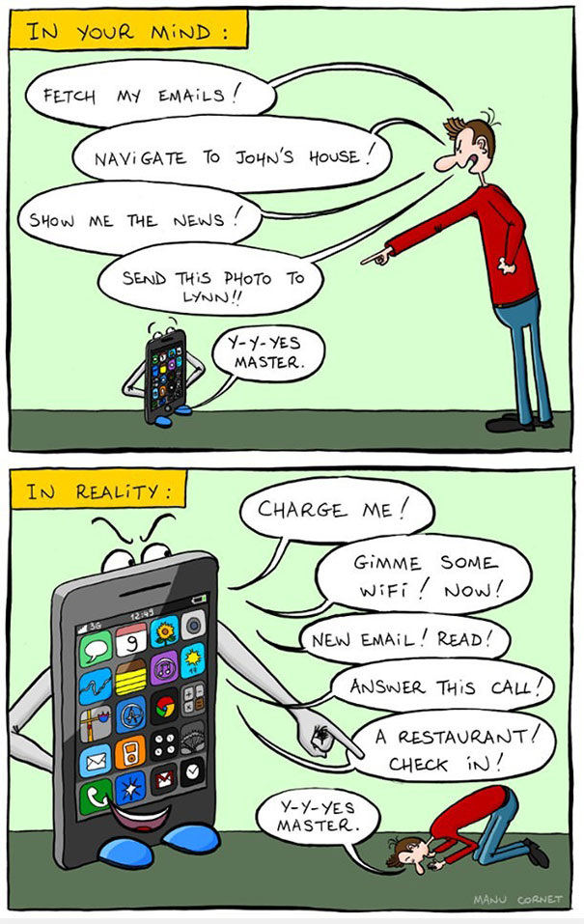
Today’s Topics
Social Media in Workplace Investigations;
Social Media and Harassment/Retaliation/Discrimination;
Social Media and Florida’s Public Employees
Relations Act;
Social Media and First/Fourth Amendment
Protections;
Social Media and the ECPA/SCA;
Discovery and Social Media;
Social Media in Ongoing Litigation.

Slide 24
Public Employees’ Privacy Right in Social Media
Social Media Protections under the First Amendment.
Within the Eleventh Circuit, a public employee can sustain a claim of retaliation for protected speech under the First Amendment if the employee can show the following by a preponderance of the evidence:
(1) the employee’s speech is on a matter of public concern;
(2) the employee’s First Amendment interest in engaging in the speech outweighs the employer’s interest in prohibiting the speech to promote the efficiency of the public services it performs through its employees; and
(3) the employee’s speech played a “substantial part” in the employer’s decision to demote or discharge the employee. Once the employee succeeds in showing the preceding factors, the burden then shifts to the employer to show, by a preponderance of the evidence, that “it would have reached the same decision . . . even in the absence of the protected conduct.”
See Battle v. Bd. of Regents, 468 F.3d 755, 760 (11th Cir. 2006).

Slide 25
Public Employees’ Privacy Right in Social Media
In determining whether a public employee’s speech is entitled to constitutional protection, the court asks “whether the employee spoke as a citizen on a matter of public concern. If the answer is no, the employee has no First Amendment cause of action based on his or her employer’s reaction to the speech.” Battle at 760 citing Garcetti v. Ceballos, 126 S. Ct. 1951, 1958 (2006) (citations omitted).
Furthermore, the United States Supreme Court has explained that, “when public employees make statements pursuant to their official duties, the employees are not speaking as citizens for First Amendment purposes, and the Constitution does not insulate their communications from employer discipline.” Garcetti, 126 S. Ct. at 1960.

Slide 26
Public Employees’ Privacy Right in Social Media
The number of cases involving the application of First Amendment protection in the context of social media has been growing.
Cases wherein public employee’s social media use was protected under the First Amendment:
Velazquez v. Autonomous Municipality of Carolina, et al, No. 11-1586, 2012 WL 6552789 at *9 (D.P.R. Dec. 14, 2012) (holding that the plaintiff stated a First Amendment retaliation claim based on Facebook comments criticizing her employer for “making decisions that jeopardized the smooth and efficient operations of the Municipal Police . . . , putting in harms way the life of fellow officers” and for posting pictures of a fellow employee sleeping on the job);
Greer v. City of Warren, No. 1:10-cv-01065, 2012 WL 1014658 at *7 (W.D. Ark. Mar. 23, 2012) (ruling that a confederate flag display on a police officer’s MySpace page was protected speech).

Slide 27
Public Employees’ Privacy Right in Social Media
Cases wherein public employee’s social media use was not protected by the First Amendment:
Dible v. City of Chandler, 515 F.3d 918 (9th Cir. 2008) (ruling that a police officer terminated for operating a sexually explicit website did not have a viable First Amendment claim);
Yoder v. University of Louisville, No. 3:09-CV-00205, 2012 WL 1078819 (W.D. Ky. Mar. 30, 2012) (finding that a nursing student’s First Amendment claim failed where the student posted patient information on the student’s MySpace page in violation of the school’s confidentiality agreement).

Slide 28
Public Employees’ Privacy Right in Social Media
Recent issue: Is “liking” a post on social media protected by the First Amendment?
Bland, et. al v. Roberts 857 F. Supp. 2d 599 (E.D. Va. 2012): Court holds that merely “liking” a Facebook post was “insufficient speech to merit constitutional protection.”

Slide 29
Public Employees’ Privacy Right in Social Media
Bland, however, was reversed on appeal (730 F.3d 368 (4th Cir. 2013):
The Fourth Circuit explained that “liking a political candidate’s campaign page communicates the user’s approval of the candidate and supports the campaign by associating the user with it.”
As explained by the appellate court, "liking" is "the Internet equivalent of displaying a political sign in one’s front yard, which the Supreme Court has held is substantive speech."

Slide 30
Public Employees’ Privacy Right in Social Media
Munroe v. Central Bucks Sch. Dist., 805 F.3d 454 (3d Cir. 2015):
A high school English teacher was terminated for posting derogatory comments about her students on a blog post, including proposed report card comments like “lazy a*****e” and “dresses like a street walker.”
The teachers’ comments caused significant parental backlash. After the school eventually terminated the teacher, she brought claims for First Amendment retaliation, which were dismissed.
The appellate court upheld the dismissal of the teacher’s claims, explaining that the school district’s interest in efficiently providing a public service outweighed the teacher’s interest in making the speech.
In so ruling, the court explained that the teacher’s speech was “sufficiently disruptive so as to diminish any legitimate interest in its expression, and thus her expression was not protected.”

Slide 31
Public Employees’ Privacy Right in Social Media
Social media protection under the Fourth Amendment.
While the Fourth Amendment protects public employees from unreasonable searches, in the context of social media, courts have not been clear in defining what is “unreasonable.”
Although not a social media case, City of Ontario v. Quon,130 S.Ct. 2619 (2010), is worth considering as a reference.

Slide 32
Public Employees’ Privacy Right in Social Media
Quon’s Facts:
Involved the Ontario Police Department’s search of an employee’s text messages on his employer-issued pager.
The Police Department had a policy reserving “the right to monitor and log all network activity, including email and internet use, with or without notice to employees.”
Employees were told text messages would be treated the same as emails and the policy stated that “users should have no expectation of privacy or confidentiality when using these resources.”
While the Police Department had a policy that all text messages were subject to monitoring, the employee’s supervisor suggested to him and other officers that he would not enforce the policy of inspection.
After an audit that included a review of the text messages, the Police Department learned that many of the employee’s messages were personal and he was disciplined for violating the department’s policy.
The employee and several other officers sued under the Fourth Amendment.

Slide 33
Public Employees’ Privacy Right in Social Media
Quon’s holding:
The Supreme Court held that the search of the text messages was reasonable.
The majority found:
That the search was justified because there were “reasonable grounds for suspecting that the search [was] necessary for a noninvestigatory work-related purpose,” and
That its scope was reasonable because it was limited to two months and reading the transcript was an efficient way to determine if the device was used for personal activity.
The Court also found it was unreasonable for the employee to believe that his personal communications on an employer-provided device would be immune from an audit.

Slide 34
Public Employees’ Privacy Right in Social Media
Twitter privacy has also been the subject of Fourth Amendment litigation.
Case illustration: Rosario v. Clark County School District, 2013 WL 3679375, *5 (D. Nev. 2013).
In Rosario, the court denied a student Fourth Amendment protection in connection with Twitter postings based on a lack of any reasonable privacy expectation.
Privacy settings do not necessary provide an expectation of privacy to employees.

Slide 35
Public Employees’ Privacy Right in Social Media
Interestingly, in the criminal context, courts have held that individuals have an expectation of privacy in connection with their own cell phones:
See Tracey v. State of Fla., 152 So. 3d 504 (Fla. 2014) (holding that the defendant had a reasonable expectation of privacy in real time cell site location information (CSLI) regarding location of the defendant’s cellular telephone, as would support finding that police officers’ use of CSLI to track defendant was a search falling under purview of Fourth Amendment)
This type of analysis could be applied in the employment context, particularly if an employer, for instance, was able to track an employee through the employee’s personal cell phone and GPS technology, and took action based on that, if a reasonable expectation of privacy exists.

Slide 36
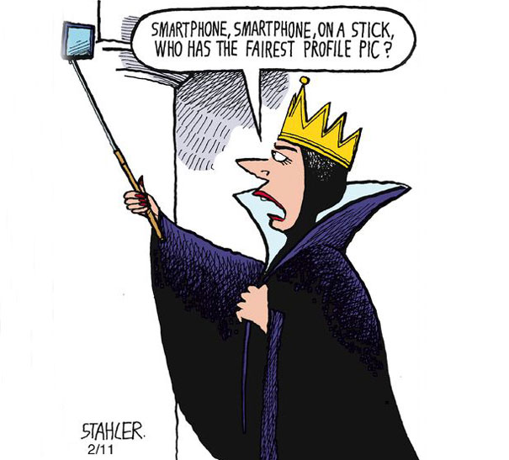
Today’s Topics
Social Media in Workplace Investigations;
Social Media and Harassment/Retaliation/Discrimination;
Social Media and Florida’s Public Employees
Relations Act;
Social Media and First/Fourth Amendment
Protections;
Social Media and the ECPA/SCA;
Discovery and Social Media;
Social Media in Ongoing Litigation.

Slide 37
Employees’ Privacy Right in Social Media
Other protections afforded to social media use: The Electronic Communications Privacy Act (“ECPA”).
Congress enacted the EPCA “to update and to clarify federal privacy protections and standards in light of dramatic changes in new computer and telecommunications technologies.”
More recently, the ECPA was updated to include the Stored Communications Act (“SCA”), 18 U.S.C. §§ 2701-2712, which prohibits the intentional access of stored communications without authorization.
Cases interpreting the application of these statutes in the context of social media are becoming more prevalent.

Slide 38
Employees’ Privacy Right in Social Media
Case Illustration:
Rodriguez v. Widener University, No. 13-1336, 2013 WL 3009736 (E.D. PA June 17, 2013) (declining to dismiss a claim brought under the ECPA and SCA based on allegedly unlawful access to the plaintiff’s Facebook account despite university’s argument that the posts “were accessible to the general public and/or forwarded to [the defendants] by concerned students who had equal and permitted access to [the plaintiff’s] Facebook postings”).

Slide 39
Employees’ Privacy Right in Social Media
Accessing of personal email, especially after an employee has left the entity or agency also continues to be problematic:
See, e.g., Lazette v. Kulmatycki, 949 F. Supp. 2d 748 (N.D. Ohio 2013):
In Lazette, the employee's former supervisor continued to access the plaintiff's personal email account for some 18 months (and viewing some 48,000 emails) after her departure, claiming he was “authorized” to do so both because the former employee had failed to properly delete the account from her phone before turning it in and because she failed to tell the employer not to access her personal emails during the 18 months following the end of her employment. At the motion to dismiss stage, the court held that the SCA applied and declined to dismiss the claim.

Slide 40
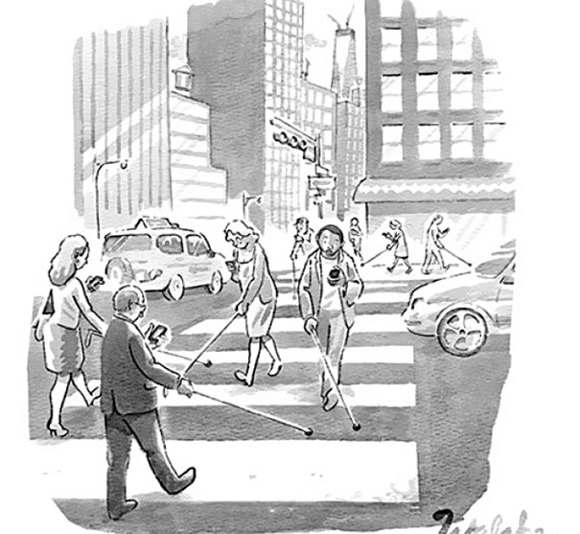
Today’s Topics
Social Media in Workplace Investigations;
Social Media and Harassment/Retaliation/Discrimination;
Social Media and Florida’s Public Employees
Relations Act;
Social Media and First/Fourth Amendment
Protections;
Social Media and the ECPA/SCA;
Discovery and Social Media;
Social Media in Ongoing Litigation.

Slide 41
Discovery and Social Media
Discoverability of social media
Social media presents a potential treasure trove of relevant evidence, but attempts at discovering the same often lead to discovery disputes.
Disputes generally fall into one of several categories:
Litigation over entitlement;
Litigation over who produces it (and how); and/or
Litigation over collateral issues surrounding discovery.

Slide 42
Discovery and Social Media
Social media material is generally discoverable if necessary thresholds are met (i.e., the material is relevant to a claim or defense and discovery of the same is not limited for reasons of oppression, embarrassment and the like).
Case Illustrations:
EEOC v. The Original Honeybaked Ham Company of Georgia, Inc., No. 11-cv-02560, 2012 WL 5430974, *2-3 (D. Col. Nov. 7, 2012) (establishing a special master process to facilitate the production and inspection of Facebook material);
Glazer v. Fireman’s Fund Ins. Co., No. 11Civ.4374, 2012 WL 1197167 (S.D.N.Y. Apr. 5, 2012) (ordering production of social media material);
E.E.O.C. v. Simply Storage Management, LLC, 270 F.R.D. 430 (S.D. Ind. 2010) (holding that postings on social networking sites were discoverable regarding emotional or mental state or other references to sexual harassment or emotional distress claims).

Slide 43
Discovery and Social Media
Courts are becoming more attuned to the nuances of social media accounts (including the volume of information they contain), and are requiring that requesting parties hone their requests based on relevance.
For example:
Palma v. Metro PCS Wireless, Inc., 18 F.Supp.3d 1346, 1347 (M.D. Fla. 2014) (noting that social media content is neither privileged nor protected by any right of privacy, but that this principle does not give defendants the right to serve overbroad discovery requests designed to rummage at will through information a plaintiff has limited from public view);
Giacchetto v. Patchogue-Medford Union Free School Dist., 293 F.R.D. 112 (E.D. N.Y. 2013) (limiting discovery to postings that specifically referenced the plaintiff’s claimed emotional distress, treatment she received, or alternative potential stressors as well as accounts of the events alleged in her amended complaint on social networking sites, whether contradictory or otherwise).
Also, Federal Rule of Civil Procedure 26(b)(1)’s new proportionality rule, which imposes a responsibility on litigants to tailor their discovery requests to account for the significance of the information requested, and the cost of gathering responsive information.

Slide 44
Discovery and Social Media
In some cases, the Stored Communications Act has served to block attempts to obtain access to social media via the provider. For example:
Crispin v. Christian Audigier, Inc., 717 F. Supp. 2d 965 (C.D. Cal. 2010) (quashing subpoenas served on Facebook and MySpace and ruling that webmail and private messaging services provided on social networking and website hosting websites were not subject to subpoena under the Stored Communications Act).
Facebook itself, on its website, states its legal position that it is not subject to civil subpoenas because it is precluded from disclosing user content under the SCA, but it now has a feature allowing users to download their information themselves.

Slide 45
Discovery and Social Media
Two fairly recent Florida appellate courts have addressed the permissibility of social media discovery:
Root v. Balfour Beatty Const. LLC, 132 So. 3d 867 (Fla. 2d DCA 2014):
A mother brought a claim for negligence on behalf of her son who was injured when a vehicle operated by the son’s seventeen year old aunt was hit by another vehicle.
The defendants raised numerous affirmative defenses, including negligent entrustment.

Slide 46
Discovery and Social Media
Throughout discovery, the trial court entered an order compelling the plaintiff to produce postings from her Facebook accounts before or after the accident regarding psychological care obtained by the plaintiff; postings, statuses, photos, likes, or videos relating to the plaintiff’s relationship with her son and other children, relationships with other family members, boyfriends, husbands and/or significant others; mental health, stress complaints, alcohol use or other substance use; and postings relating to any lawsuit filed after the accident.
On appeal, the plaintiff challenged the requests as overbroad and seeking personal information unrelated to the plaintiff’s claim for loss of consortium or defendants’ defenses.
The appellate court agreed with the plaintiff and quashed the trial court order.

Slide 47
Discovery and Social Media
Nucci v. Target, No. 4D14-138, 2015 WL 71726 (Fla. 4th DCA Jan. 7, 2015).
Involved a personal injury case arising from an injury that the plaintiff sustained while slipping on a substance on the floor at a Target.
Target initially moved to compel inspection of the plaintiff’s Facebook page, arguing that such an inspection was warranted due to the plaintiff placing her physical and mental conditions at issue.

Slide 48
Discovery and Social Media
The plaintiff objected, arguing that she had an expectation of privacy in her Facebook account and that Target’s request was overbroad. After Target agreed to narrow its request to photographs of the plaintiff, the court ordered the plaintiff to produce all social media photographs from two years after the accident and all pictures of the accident.
The plaintiff appealed, arguing, inter alia, that the request impinged upon her privacy rights, sought irrelevant documents, and sought information not discoverable under the SCA.
The appellate court held that the information was relevant as it related to the plaintiff’s damages.
The court also concluded that the requests did not violate the plaintiff’s right to privacy as social media users have an expectation that their personal information will be shared with others and because the SCA did not apply to the plaintiff.

Slide 49
Discovery and Social Media
Although Root and Nucci did not involve employment claims, their holdings concerning the discoverability of social media may impact employment cases.
Indeed, Root and Nucci address the same arguments commonly raised by plaintiffs and defendants in employment law cases implicating social media discovery disputes, including those discussed above.

Slide 50
Discovery and Social Media
Both the plaintiff and defense attorneys must be sensitive to the issues of social media discovery and the risks of spoliation.
Case Illustration:
Gatto v. United Airlines, No. 10-cv-1090, 2013 WL 1285285 (D. N.J. Mar. 25, 2013):
Several defendants sought sanctions for spoliation related to the deletion of a plaintiff’s Facebook account.
The plaintiff deactivated his Facebook account after learning it had been accessed by an unfamiliar IP address. In doing so, he triggered an automatic 14-day deletion by Facebook, resulting in all contents being lost.
While various aspects of production were disputed, the Court ultimately concluded that, regardless of the reason, the plaintiff had intentionally deactivated the account, which caused evidence to be lost. For that reason, the Court ordered that an adverse inference instruction was to be given at trial.

Slide 51
Discovery and Social Media
It is important for employers to preserve social media information that they discover at the time of the discovery.
Florida Bar Advisory Opinion 14-1 makes this even more important as it allows attorneys to advise their clients to increase social media privacy setting and remove social media content at the pre-litigation stage.
However, they must take steps to preserve the information.

Slide 52
Discovery and Social Media
Note: Deactivating a social media account doesn’t protect an employee against disclosure:
Crowe v. Marquette Transportation No. 14-1130 (E.D. La. Jan. 20, 2015) (ordering an employee to produce an unredacted copy of his entire Facebook page, finding that his argument that he had deactivated his Facebook account was not persuasive—that was not the same as deleting it, and it was clear from other evidence that he knew how to reactivate his account. Moreover, the employer was entitled to analyze his Facebook messages, particularly given evidence that he messaged a coworker that he injured himself fishing, rather than in a workplace accident on the employer’s vessel, as he had alleged)

Slide 53
Discovery and Social Media
Parties should also be sensitive to the impact of “Bring Your Own Device” (BYOD) policies on discovery.
Although legal guidance on BYOD policies is scant, such policies implicate numerous concerns, including:
Issues surrounding lost or stolen devices;
Confidentiality of health-protected information contained on employee-owned devices;
The protection of company trade secret/confidential information contained on employee-owned devices;
Overtime/minimum wage issues under the Fair Labor Standards Act; and
Public records concerns under Chapter 119, Florida Statutes.

Slide 54
Discovery and Social Media
At least one court has addressed the BYOD issue. See (Cotton v. Costco Wholesale Corp, No. 12-2731, 2013 WL 3819974 at *6 (D. Kan. July 24, 2013).
In Cotton, the court denied a plaintiff’s motion to compel text messages sent or received by employees on their personal cell phones because of a lack of any showing that the employer had any legal right to obtain the text messages.
The decision was based on the lack of custody or control, with the court noting that the plaintiff had not claimed that Costco issued the phones or that the employees had used their phones for work-related business. The outcome could be different if BYOD was the policy.

Slide 55
Discovery and Social Media
Social media also implicates evidentiary concerns.
To the extent that parties attempt to use social media postings or comments as evidence to support or refute employment claims, they must consider evidentiary issues, including authentication and hearsay issues, surrounding such evidence:
In re Carrsow-Franklin, 456 B.R. 753, 756-57 (Bankr. D.S.C. 2011) (explaining that blogs are not self-authenticating and rejecting blog evidence due to failure to present authentication testimony);
Miles v. Raycom Media, Inc., No. 1:09cv713-LG-RHW, 2010 WL 4791764 *3 n.1 (S.D. Miss. Nov. 18, 2010) (holding that unsworn statements made on Facebook page by nonparties were inadmissible under FRE 801).

Slide 56
Conclusion
Social media has caused, and continues to cause, many legal issues in the employment law arena.
Because social media cases and decisions are issued nearly every day, it is impossible to capture them all in single presentation.
Both employers and employees must be cognizant of social media issues and topics, and be on the lookout for new developments in this evolving area of the law.

Slide 57
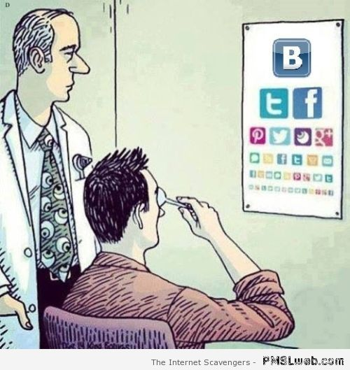
Today’s Topics
Social Media in Workplace Investigations;
Social Media and Harassment/Retaliation/Discrimination;
Social Media and Florida’s Public Employees
Relations Act;
Social Media and First/Fourth Amendment
Protections;
Social Media and the ECPA/SCA;
Discovery and Social Media;
Social Media in Ongoing Litigation.

Slide 58
Social Media in Litigation
Litigants must also be cognizant of their use of social media during litigation.
Case Illustration: Gulliver Schools, Inc. v. Snay, 137 So.3d 1045 (Fla. 3d DCA 2014).
A headmaster sued a school for age discrimination and retaliation. The parties entered into settlement agreement wherein the school agreed to pay $90,000 to him and $60,000 to his attorneys in exchange for a general release.
The settlement agreement included a confidentiality provision providing that a portion of the settlement proceeds would be disgorged if the headmaster or his wife violated the confidentiality provision.
After the parties signed the settlement agreement, the school notified the headmaster that he had breached the agreement due to a Facebook posting by the headmaster’s college-age daughter stating, “Mama and Papa Snay won the case against Gulliver. Gulliver is now officially paying for my vacation to Europe this summer. SUCK IT.” The post was viewable by the daughter’s approximately 1,200 friends, many whom were current or past students of the school.
Subsequently, counsel for the school tendered payment of the attorney’s fees sum to the headmaster’s counsel, but withheld the remaining payments on the basis that the headmaster had breached the settlement agreement’s confidentiality provision.

Slide 59
Social Media in Litigation
The headmaster subsequently filed a motion to enforce the settlement agreement, which the lower court granted.
On appeal, the appellate court reversed the lower court, explaining that the confidentiality provision was unambiguous and that the headmaster’s admission that he had told his daughter that the case had settled and that he was happy with the results violated the provision.
Gulliver underscores the importance of, and enforceability of, confidentiality provisions and the dangers of social media surrounding the same.
Employees and employers would be wise to refrain from commenting on active litigation through social media channels.

Slide 60
Conclusion
Social media has caused, and continues to cause, many legal issues in the employment law arena.
Because social media cases and decisions are issued nearly every day, it is impossible to capture them all in single presentation.
Both employers and employees must be cognizant of social media issues and topics, and be on the lookout for new developments in this evolving area of the law.

Slide 61
QUESTIONS?

