Slide 1
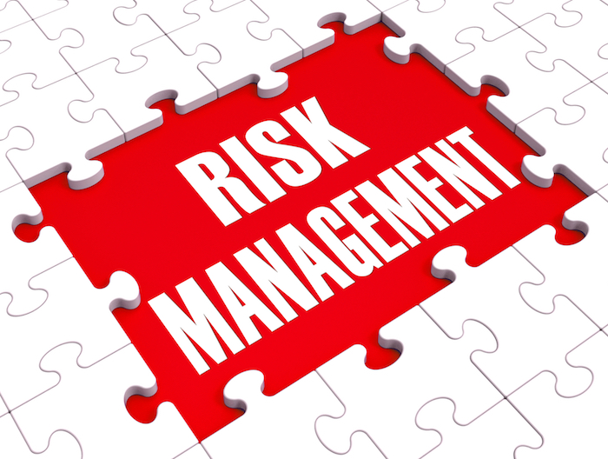
Risk and Safety Management Tools

Slide 2
Key Principle #1
There are 3 major subsystems that must be dealt with to prevent incidents 1. Physical 2. Managerial 3. Behavioral

Slide 3
Question….
What are the items (tasks) that you are doing to “manage” safety within your organization?
_______________
_______________
_______________
_______________
_______________
_______________
_______________
_______________

Slide 4
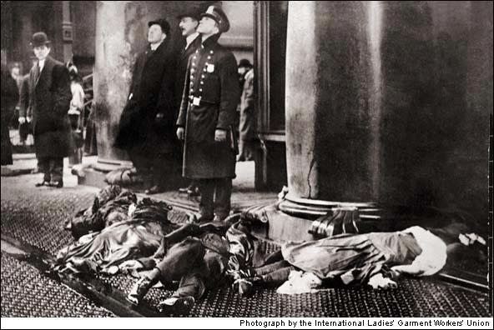
A Brief Historical Look at Risk and Safety Management

Slide 5
History of Safety Management
THE INSPECTION ERA
Concentrated on cleaning up the hazardous conditions
Somewhat successful results
1911 (21,000 workplace deaths)
1933 (14,500 workplace deaths)

Slide 6
THE INSPECTION ERA
W.H. Heinrich published Industrial Accident Prevention (1931)
Still the foundation that most “safety programs” are based on today!

Slide 7
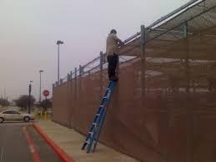
THEN CAME THE UNSAFE ACT AND CONDITION ERA
Heinrich suggested that many incidents are caused by people not hazards
Concentrated on:
cleaning up unsafe conditions
and training workers to make them safe

Slide 8
INDUSTRIAL HYGIENE and NOISE ERAʻs
In the 30ʻs, 40ʻs and 50ʻs occupational diseases and work related hearing loss became a factor.
Now we had to concentrate on:
unsafe conditions
unsafe behavior
unsafe environmental conditions
noise

Slide 9
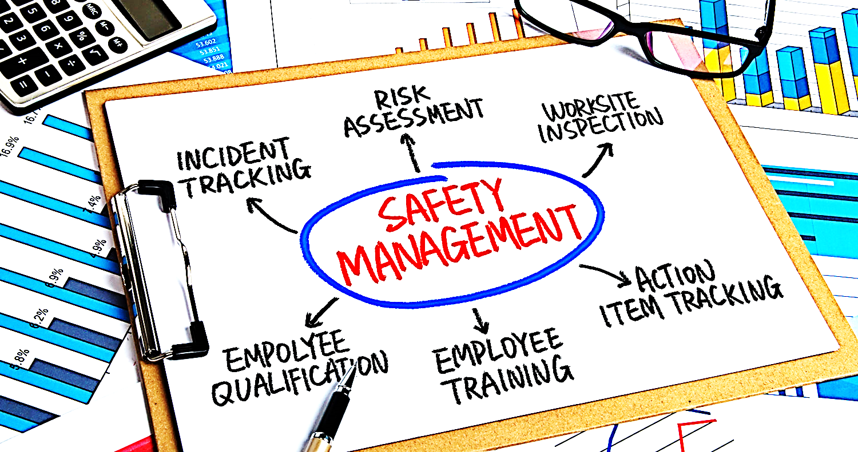
SAFETY MANAGEMENT ERA
In the late 50ʻs and 1960’s the idea of Safety “Management” was born
Set policies, clarified authorities, defined responsibilities
Used the same management tools as other disciplines:
Statistics, charts, sampling, human factors engineering, etc.

Slide 10
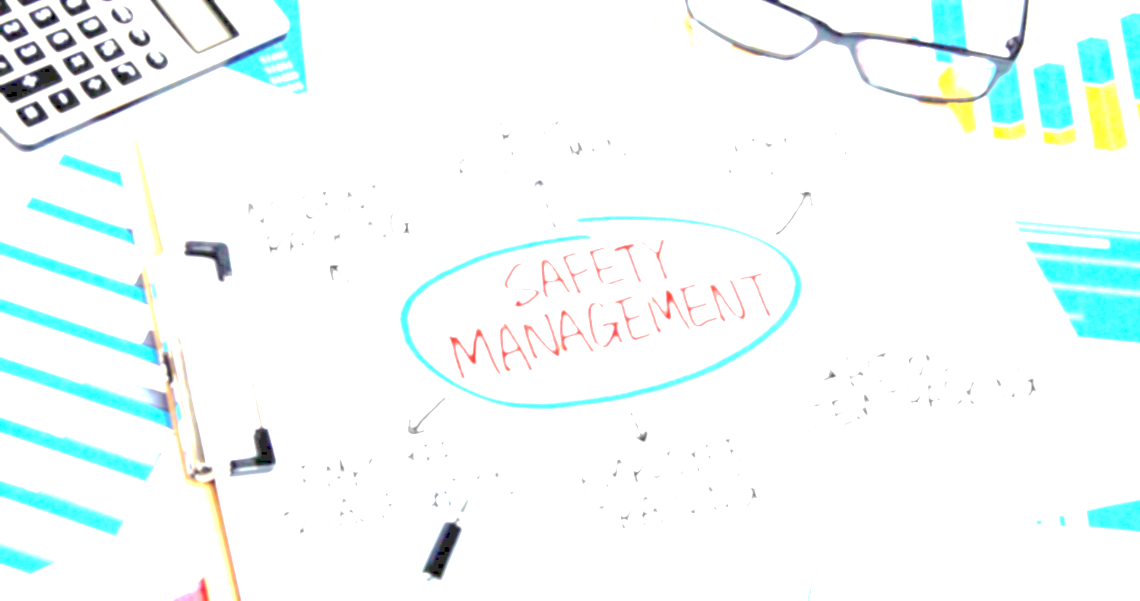
SAFETY MANAGEMENT ERA (cont)
Frequency dropped
1931- 15.12
1961- 5.99
Severity dropped
1931- 1,590
1961- 665

Slide 11
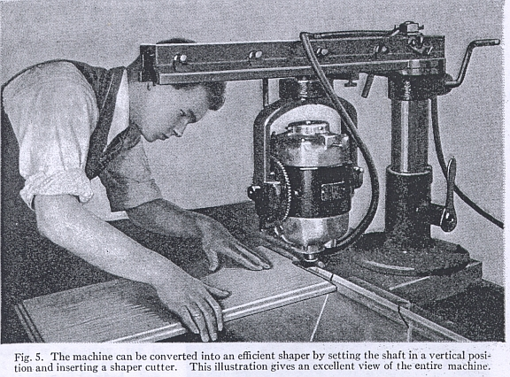
SAFETY MANAGEMENT ERA (cont)
Midway through this era we were on the threshold of a new era called….
The Psychology of Safety Management
Then guess what happened in 1970…..

Slide 12
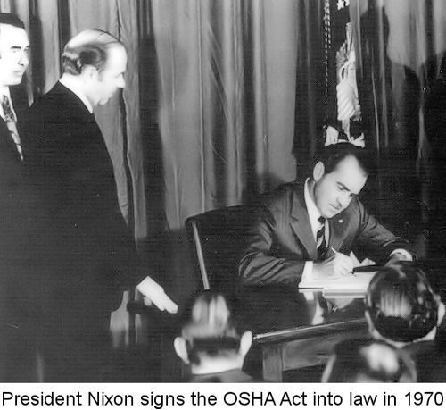
THE OSHA ERA
In 1970 OSHA placed the primary focus back on physical conditions
Emphasized the “physical”
Deemphasized the:
“managerial”
“behavioral”
Sounds like THE INSPECTION era doesn’t it?

Slide 13
Question: Where do YOU think we should be today?
Answer: You should have no “safety program”, no “safety director”, no “safety training”, no “safety incentives”, no “safety committee”, and so on…

Slide 15
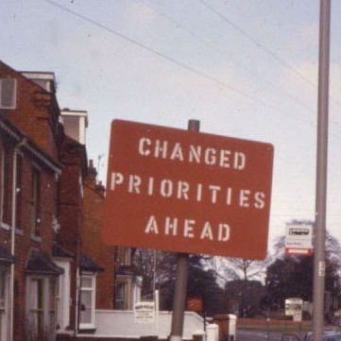
Huh?!? No Safety…
Instead of separating “safety” from the rest of the operations it should be integrated into every aspect!
DO NOT make safety a “priority” because priorities change
Safety must be a value, or when push comes to shove it will lose!

Slide 16
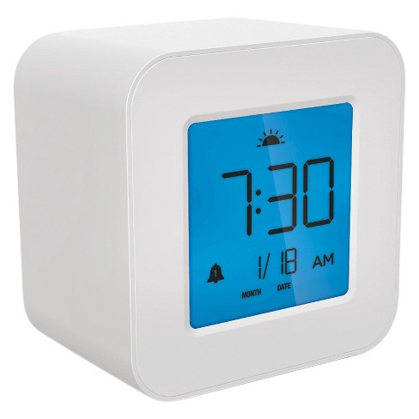
Example: Values vs. Priorities
What are your priorities in the morning?
_______________
_______________
_______________
_______________
_______________
_______________
_______________
_______________
What are your priorities in the morning …if you wake up 30 min late?
_______________
_______________
_______________
_______________
_______________
_______________
_______________
_______________

Slide 17
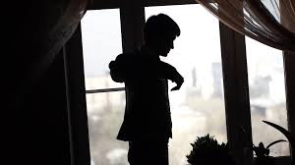
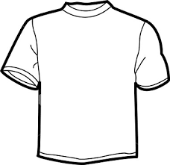
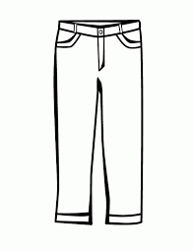
Out of Those “Priorities” Which One Was Always Constant?
YOU GOT DRESSED!

Slide 18
Welcome to….. THE MODERN RISK and SAFETY ERA
Uses modern business management tools
Goal setting
Auditing
Performance measurement
Behavior management
THE MODERN RISK and SAFETY ERA

Slide 19
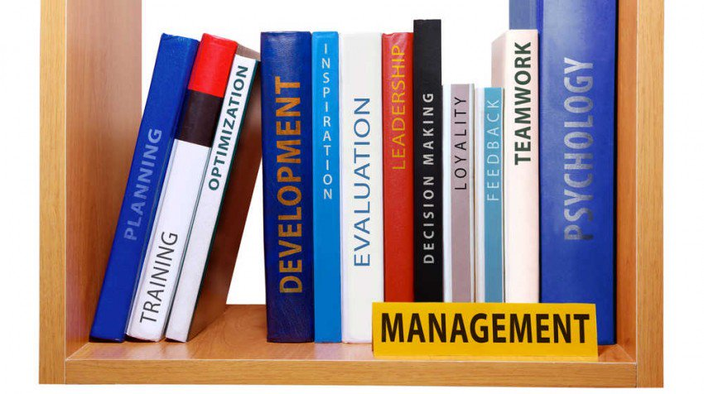
Management Direction?
Consider the differences in how your organization handles scheduling, attendance, and so on…

Slide 20
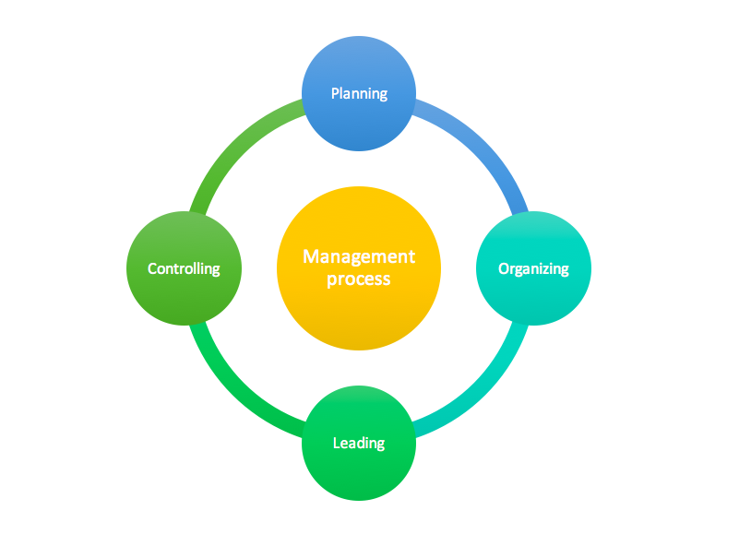
Management Direction?
When management wants something done they tell someone to do it and they expect it to be done!
Plan, Organize, Lead, Control!

Slide 21
Management Direction? (Cont)
For safety we use:
Committees
Posters
Literature
Contests
Gimmicks, (i.e. bingo)
Plus many more that we would not even consider to use for any other business process

Slide 22
Get your work done bingo?
Show up on time bingo?

Slide 23
Safety Management

Slide 24
Key Principle #2
Safety should be managed like any other organizational function. Management should direct the safety effort by setting achievable goals, by planning, organizing, leading and controlling until those goals are achieved.

Slide 26
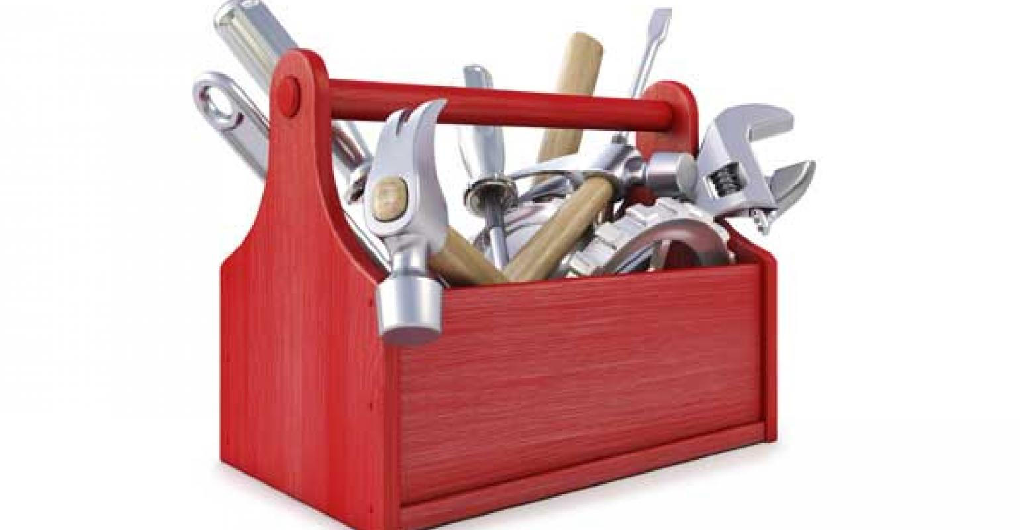
Tools to Address Physical Hazards (Safety Inspections)

Slide 27
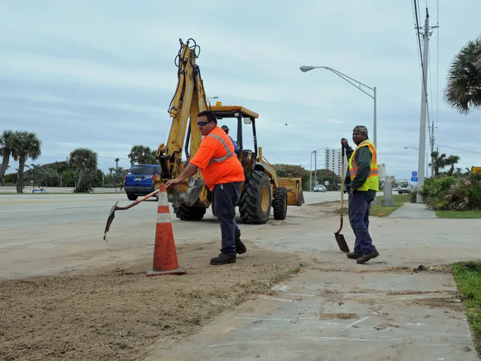
Remember we must address all 3 major subsystems
Physical
Managerial
Behavioral

Slide 28
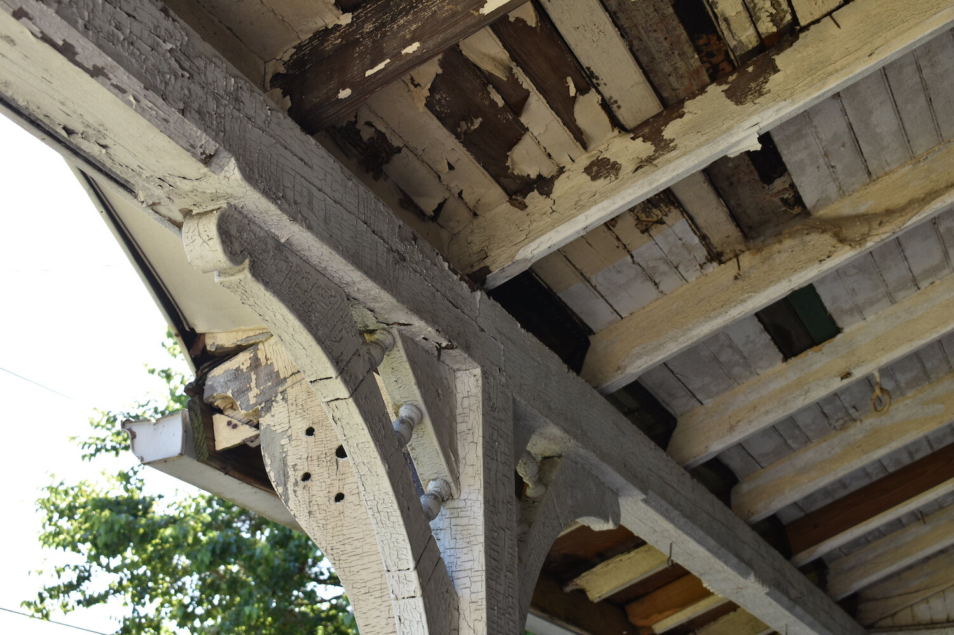
Develop a Proactive Inspection Program
Sometimes we are so focused on everything else that we sometimes don’t see what's right in front of us.

Slide 29
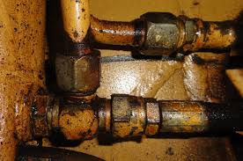
Include: City Equipment

Slide 30
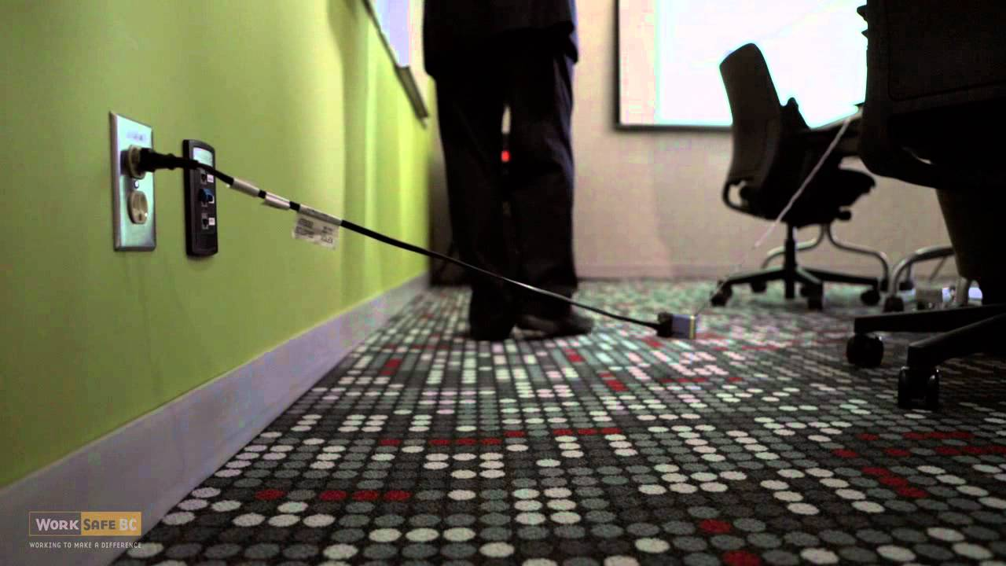
Include: City Facilities

Slide 31
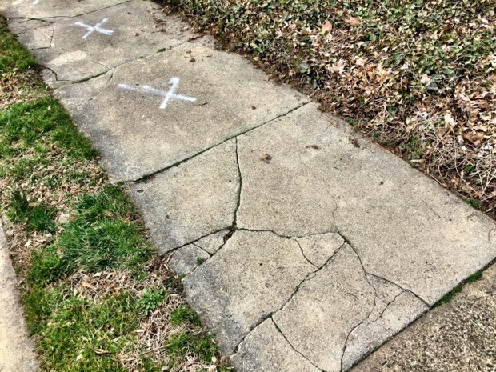
Include: City Property

Slide 32
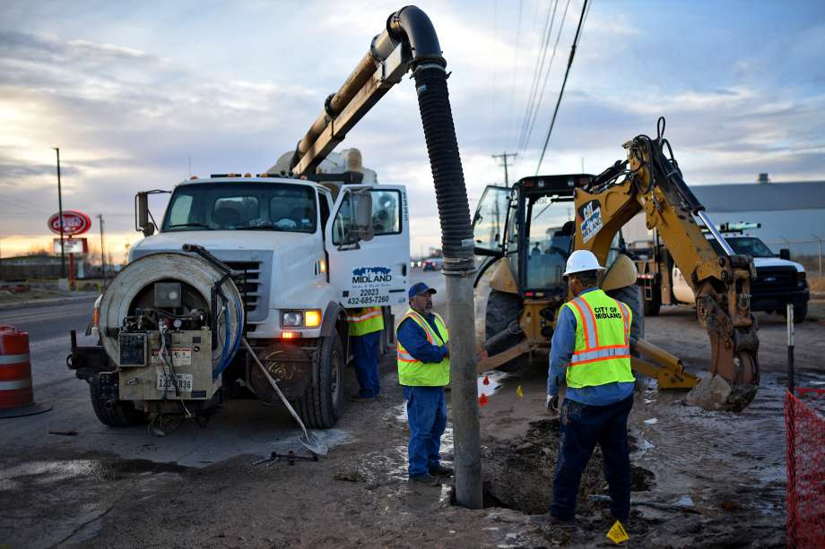
Include: City Workers

Slide 33
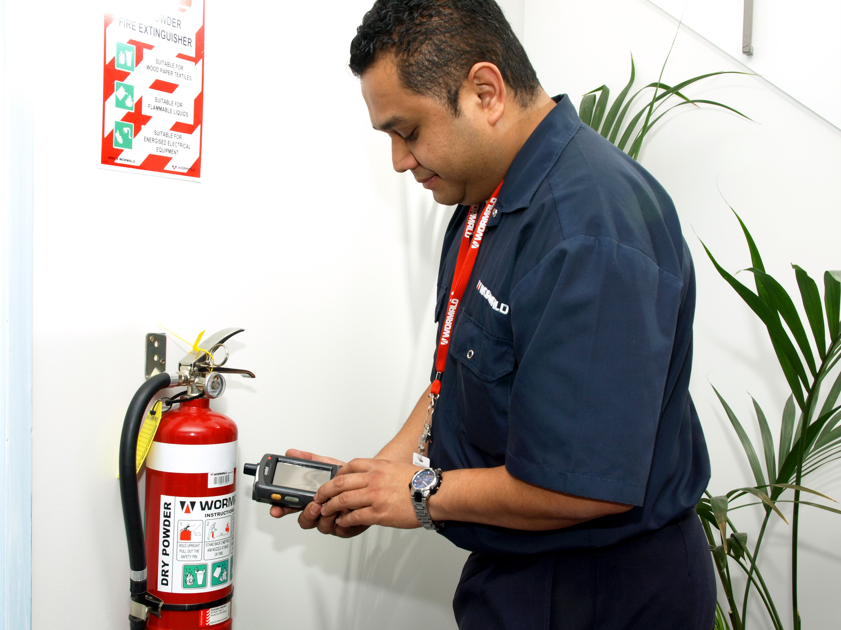
Who Should Inspect?
Elected Officials
Directors
Managers
Supervisors
Team leaders
Committee or cross functional team (if you have)
Workers
Equipment operators

Slide 34
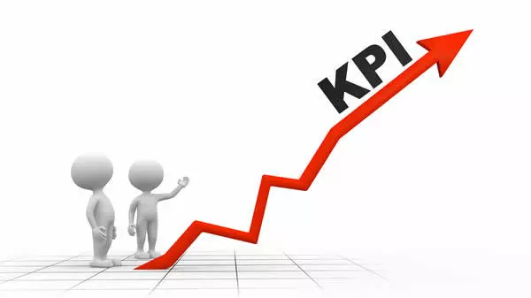
Scheduling Inspections
Develop an objective and measurable schedule:
Commercial Vehicles (Daily)
Heavy Equipment (Before Use)
Passenger Vehicles (Daily, Every Friday?)
Industrial Buildings (Weekly, Monthly, Quarterly?)
Office Buildings (Monthly, Quarterly?)
Public Areas (Low risk like a permit office- Weekly, Monthly?)
Public Areas (High risk like a splash pad- Daily?)
The schedule should state:
When to inspect each area or item
Who carries out the inspection
What degree of detail to inspect each area or item

Slide 35
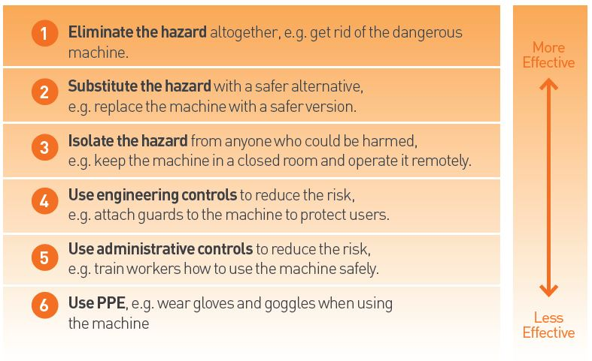
Corrective Action for Physical Hazards

Slide 36
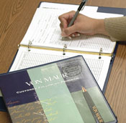
Corrective Action Tracking
Did it get fixed?
Did it get fixed on time?
Did the fix solve the root problem?
Will it stay fixed?
Suggestion: Use a Corrective Action Reporting (CAR) system to track uncorrected items!

Slide 37
Tools to Address Physical Hazards (Incident Reporting and Investigation)

Slide 38
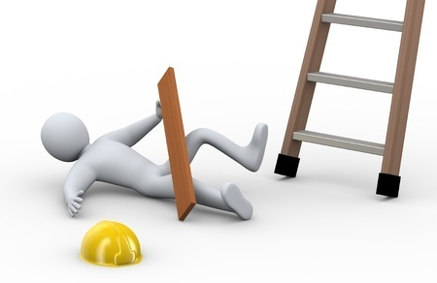
Definition of an Incident
An incident is a situation that could or does result in unintended harm or damage.
In other words... When something happened that we did not expect and it caused or could have caused us grief, we had an incident!

Slide 39
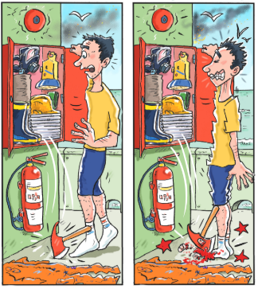
The “could have” is known as the “Near-miss” Incident
Near miss: An Incident that does not quite result in injury or damage (but could have).

Slide 40
Why do People NOT Report Incidents?
It is common for employees and supervisors to hide incidents because:
Fear of discipline
Concern about the accident record
Concern of their reputation
Fear of medical treatment
Desire not to interrupt work
Avoidance of red tape
Concern of what others might think
Poor understanding of the need to report

Slide 41
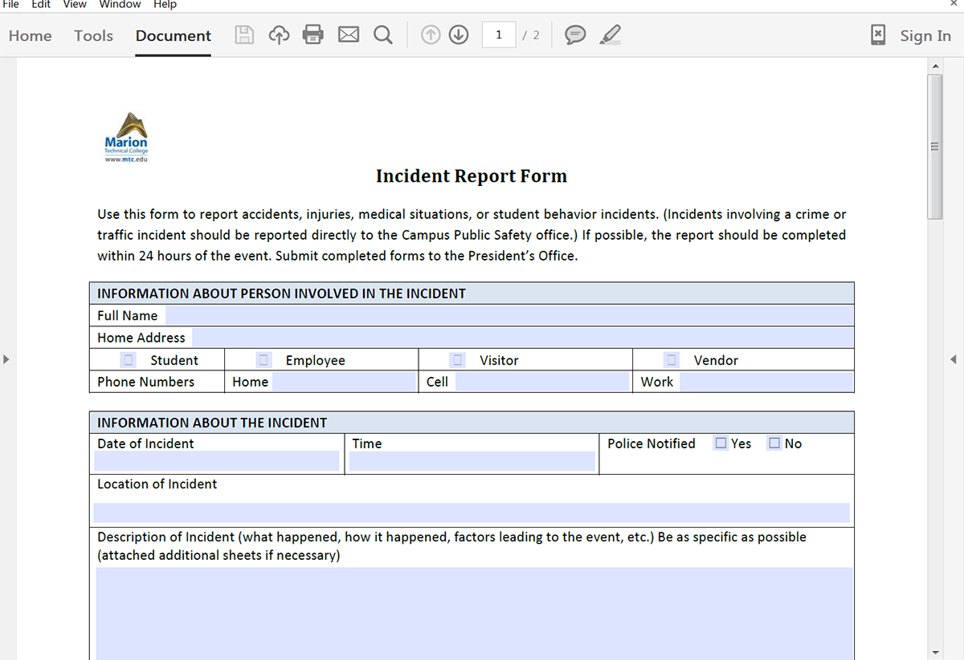
To Improve Incident Reporting
Reduce or remove all “red tape”
Make the forms easy to complete (online)
Stop measuring and rewarding safety based on incidents
Educate everyone about the need to report (prevent reoccurrence)
STOP blaming the worker for everything!
The Japanese say: “ Fix the problem, not the blame”

Slide 42
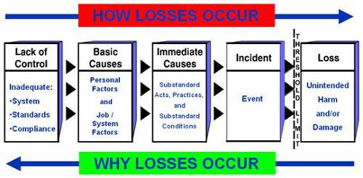
Incidents are Usually Complex Events
An incident may have multiple events that can in some way contribute to the causes

Slide 43
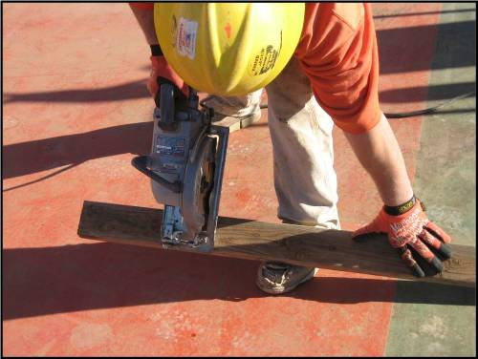
Key Principle #3
An unsafe act, condition or incident are symptoms of something wrong in the management system.

Slide 44
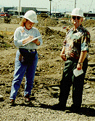
Incident Investigation Team
Front line supervisors who are trained
Management who are trained
Safety Committee rep’s who are trained
Skilled operators/workers who are trained
Consultants (especially for high potential incidents)

Slide 45
Root Cause Analysis
Use a process called 5-Whyʻs to find root causes:
Person slips on oil on floor
Why?
Oil was spilled on floor
Person stepped in oil

Slide 46
Examining Contributing Factors
Oil was spilled on floor
Person stepped in oil
Why?
Why?
Machine was being
serviced and oil spilled
Person walked through
work area

Slide 47
Examining Contributing Factors
Machine was being
serviced and oil spilled
Person walked through
work area
Why?
Why?
Spill not
prevented
Oil spill
not cleaned
Person worked in
department
Why?
Why?

Slide 48
Managerial Tools (Understanding Risk Taking)

Slide 49
Remember we must address all 3 major subsystems
Physical
Managerial
Behavioral

Slide 50
Why do people take risks?
_______________
_______________
_______________
_______________
_______________
_______________

Slide 51
Unsafe acts have been learned and are maintained, because they have been (and continue to be) reinforced by satisfying events

Slide 52
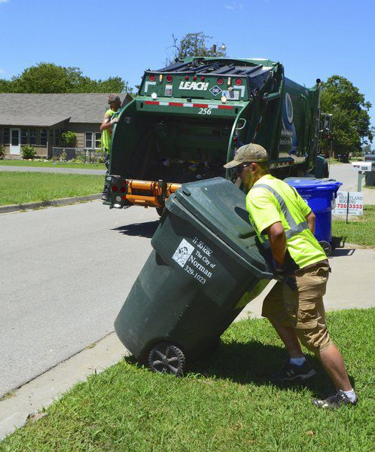
Satisfying Events?
In other words good things happen for people who take risks. (Most of the time!)
Avoiding Effort
Improved Comfort
Personal satisfaction
Pay strategies, performance measurement, culture acceptance, etc…
Example: Trash Collectors

Slide 53
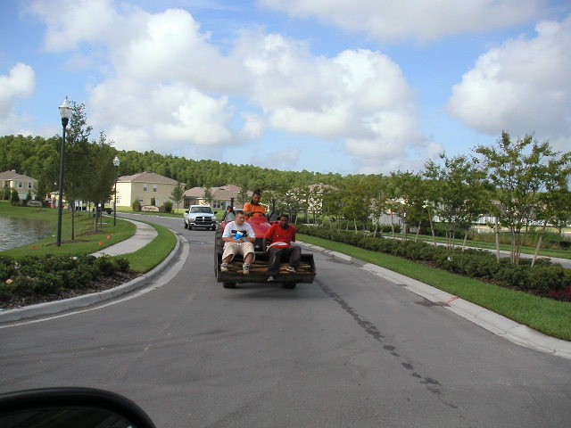
Benefits From Being Unsafe
Unsafe acts “make real sense’’ to most employees.
May attract the attention of co-workers
Thrill of taking a chance
Satisfaction of bucking authority
Employees often perceive this an incentive to take risks, as long as it more productive.
This is normal behavior!

Slide 54
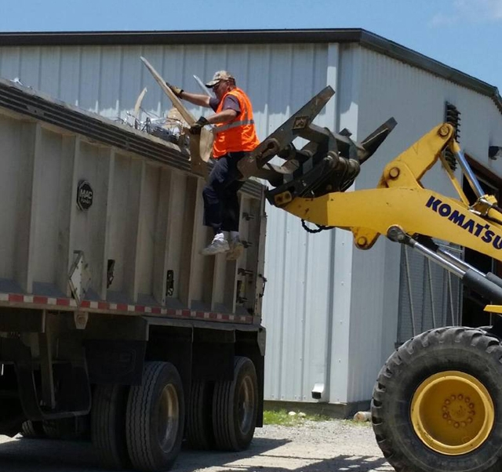
Understanding why people take risks is crucial to understand why the managerial and behavioral aspects are so important!

Slide 55
Key Principle #4
In most cases unsafe behavior is normal human behavior; it is the result of normal people reacting to their environment. It is our job to change the environment that leads to unsafe behavior!

Slide 56
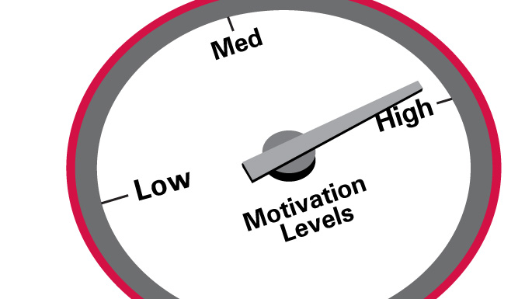
SO HOW DO WE MOTIVATE EMPLOYEES TO BE SAFE?
To measure is to motivate!

Slide 57
Managerial Tools (Performance Measurement)

Slide 58
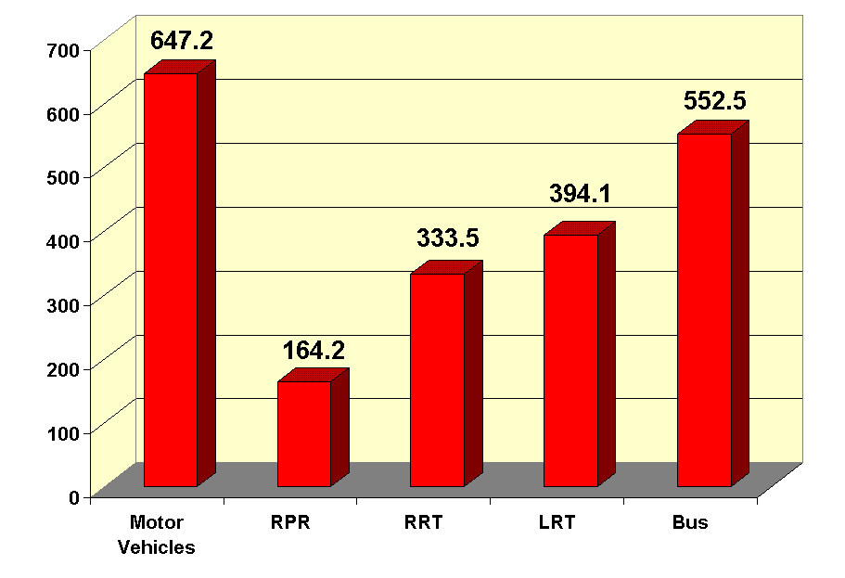
To Measure is to Motivate!
The problem is what do we measure?
Safety is opposite of from other key business processes.
If we do everything right nothing happens!
Insurance Rates

Slide 59
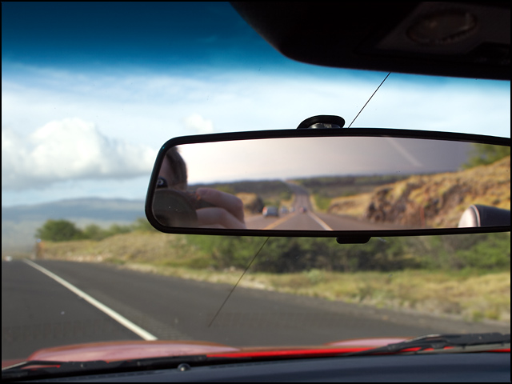
Types of Safety Measurements
Results Measures
Performance Measures
After the Incident
(Lagging Indicators)
Before the Incident
-Are supervisors inspecting more than before?
- Are they finding and correcting more hazards?
Are more employees receiving training or orientations?
Etc…
-Are people working more safely than before?
Are physical conditions improving?
-Are there fewer incidents than before?
-Fatalities, Medical, First Aid, and so on..
- Is the severity of the incidents decreasing?
-Less dollars lost?
-Lower insurance costs?

Slide 60
Lagging Indicators- Experience Modification
Used to compute Workers Compensation premiums by comparing the loss experience of employers within the same industry.
2
1
0
Experience Modifier
Looking 3 years
in the past!

Slide 61
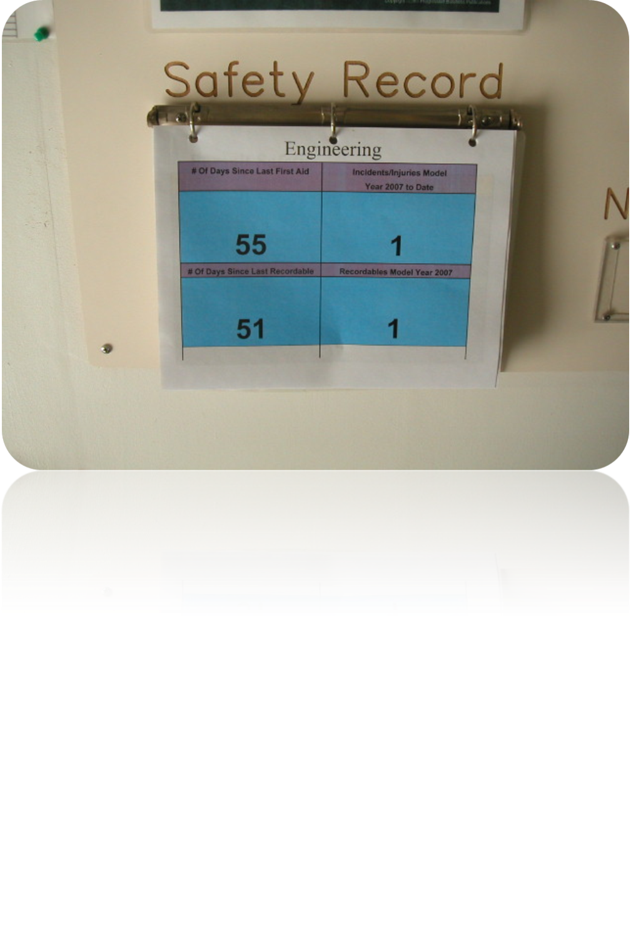
Lagging Indicators-Number of incidents
Simply count the number of incidents:
Medical
First Aid
Medical
Lost time
Property damage

Slide 62
Question: Which Organization Is Doing Better?
Organization A
260 medical cases
1 fatality
Organization B
35 medical cases
No fatalities
150, 000 employees world wide
312 Million Hours Worked/ Year
6 employees
12 Thousand Hours Worked/ Year

Slide 63
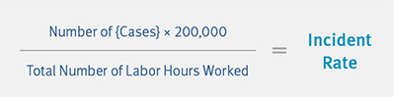
Lagging Indicators- Incident Rate
Most common methods of quantifying Safety Performance
Ratios of unwanted events
Generally a specific classification of injury (Lost time, medical, total cases) and the exposure, stated as a function of time. (I.e hours worked).

Slide 64
Question: Which Organization Is Doing Better?
Organization A
260 recordable cases
3 fatalities
Organization B
35 recordable cases
No fatalities
150, 000 employees world wide
312 Million Hours Worked/ Year
6 employees
12 Thousand Hours Worked/ Year
Incident rate of 583
Incident rate rate of 0.001

Slide 65
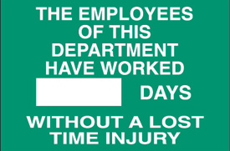
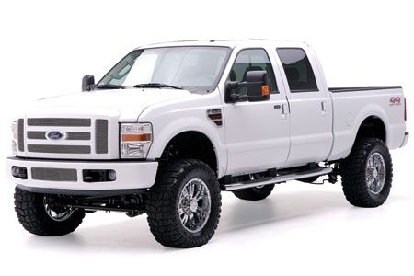
Limitations of Lagging Indicators
Measures the failure of safety not the success!
Can result in under-reporting injuries, thereby making the data statistically biased
2,999
You’ll get this truck if we make it to 3000 days without an “accident”

Slide 66
Using Only Lagging Indicators Results in this Cycle…
Incident Rates, Mod Rate, Etc….
Action taken
Action taken
Upper Limit
Lower Limit
Withdrawal
Notes:
A traditional Safety program looks at injury rates. One problem with this model is that there is a natural statistical variability in these rates. As the rates go up, management begins to emphasize Safety. As the rates go down, management and employees begin to withdraw (they focus on another squeaky wheel needing grease somewhere else).
The result is a rollercoaster ride.

Slide 67
Types of Safety Measurements
Results Measures
Performance Measures (Leading Indicators)
After the Incident (Lagging Indicators)
Before the Incident
-Are supervisors inspecting more than before?
- Are they finding and correcting more hazards?
Are more employees receiving training or orientations?
Etc…
-Are people working more safely than before?
Are physical conditions improving?
-Are there fewer incidents than before?
-Fatalities, Recordable, First Aid, and so on..
- Is the severity of the incidents decreasing?
-Less dollars lost?
-Lower insurance costs?

Slide 68
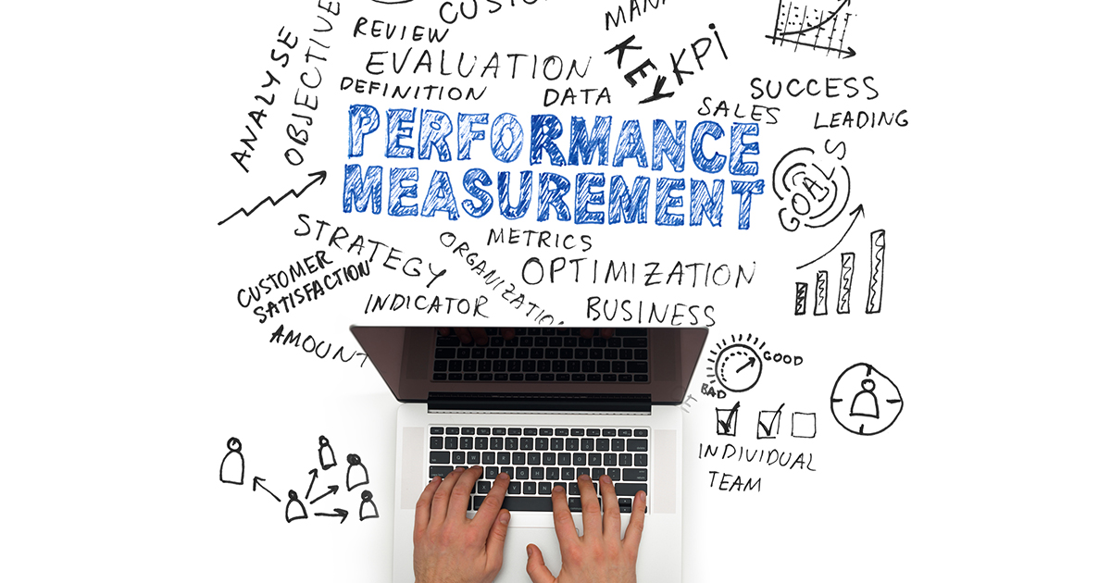
Performance Measurement
Safety must be specifically defined in everyone's roles.
Safety must be measured like other key business topics.
Focus on leading indicators (i.e. what we are doing to manage Safety).
Good Safety performance must be recognized.
Inadequate performance must be corrected.

Slide 69
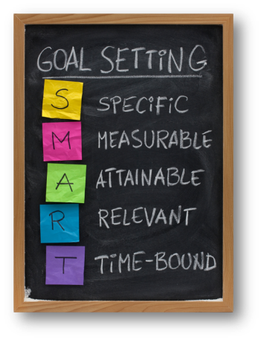
Step 1) Define your Goals
Example Goal A: We want supervisors and directors to conduct inspections
Example Goal B: We want employees to work safer
Goal X: and so on….
Notice how reducing incident rates is not a goal? Why not?

Slide 70
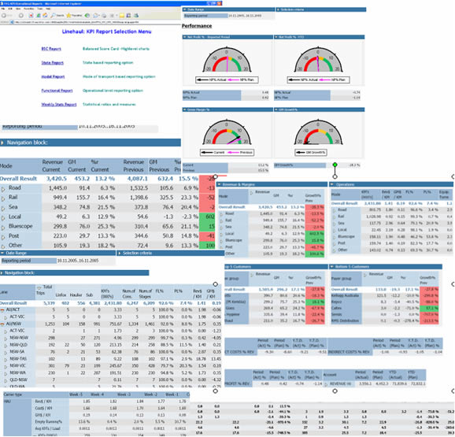
Step 2) Define Performance Indicators
What indicator(s) are we going to measure?
And how do they fit into your organizations KPI’s?

Slide 71
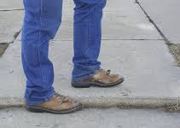
Example for Goal A: Conduct Inspections
Indicator
Workplace inspection target for each frontline supervisor across whole site on a monthly basis each with specific area Workplace visibility tour by directors in their work area once per quarter.
I never noticed that before!!

Slide 72
Step 3) Define The Measurement/Metric
Measurement/Metric
% Scheduled inspections complete by name and work area/dept. % Actions arising complete by name and work area/dept % directors tours complete
Develop metrics that can be easily applied.
Metrics need to be clear and well documented so that indicators can be applied in a consistent manner over time.

Slide 73
Review…..
Indicator | Measurement/Metric
Work place inspection target for each frontline supervisor across whole site on a monthly basis each with specific area Workplace visibility tour by senior managers in their work area once per quarter. | % Scheduled inspections complete by name and work area/dept. % Actions arising complete by name and work area/dept % Visibility tours complete

Slide 74
Example Goal B: Employees Working Safely (cont)
Indicator | Measurement/ Metric
Behavior based observation results | % Employees working safely % safe/ok

Slide 75
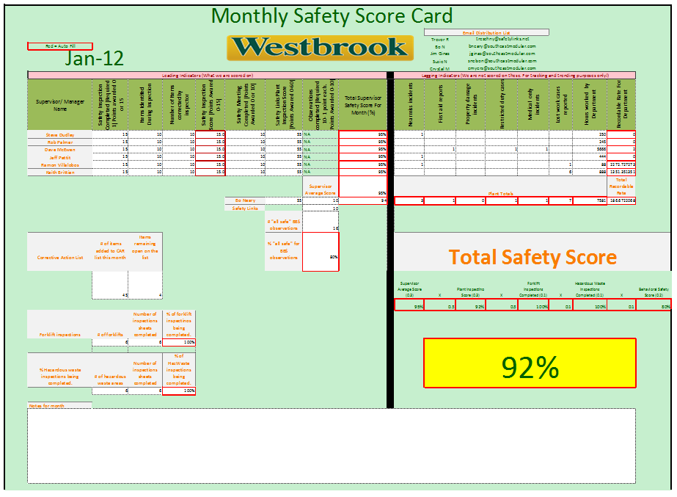
City of ????????

Slide 76
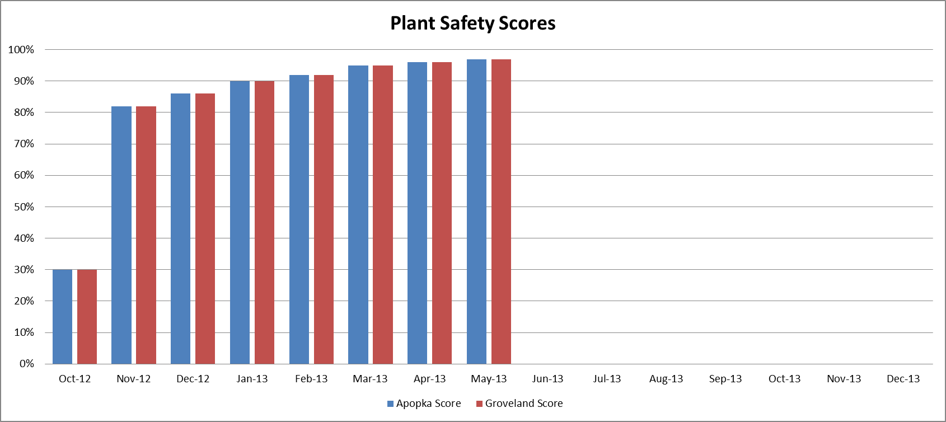
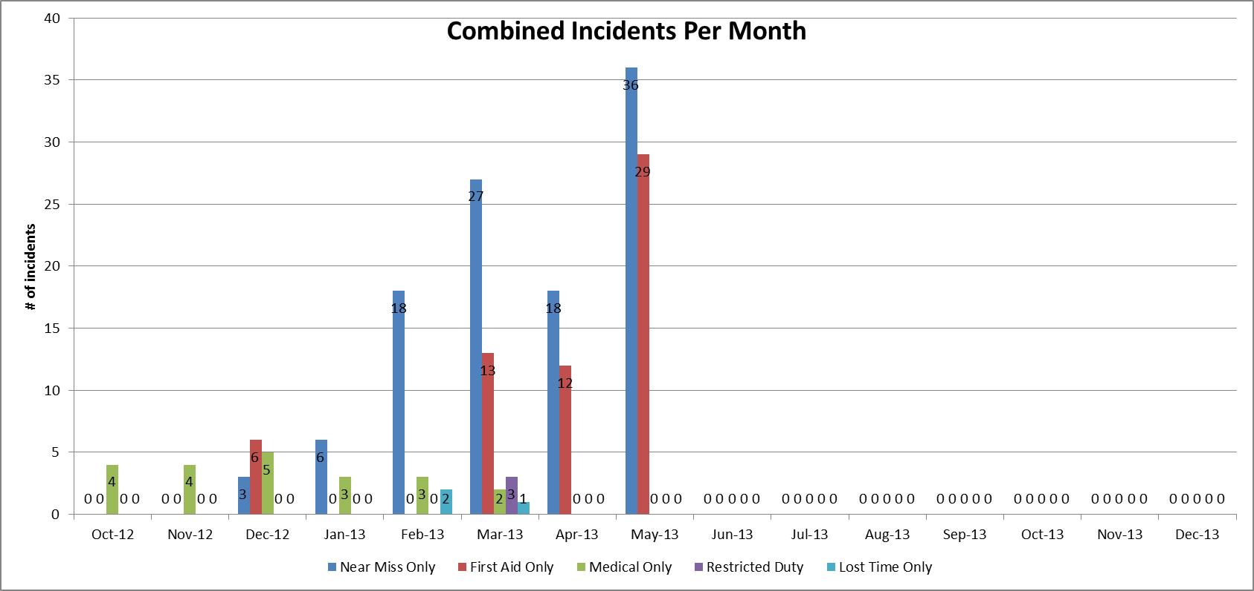
Scores Improved Immediately
Loss time, restricted, and medical dropped to Zero. First Aid and Nearmiss Reporting Skyrocketed!

Slide 77
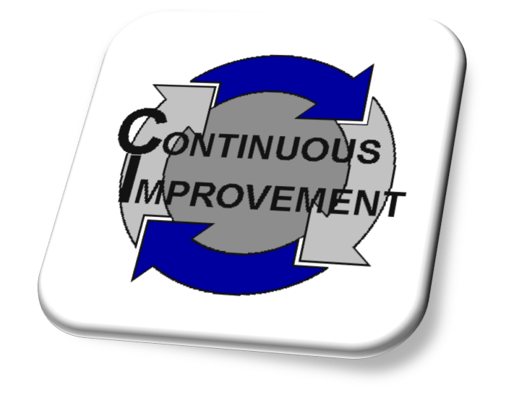
Step 4) Follow-up and Evaluation
Ensure that the indicators are well-defined
Ensure they correspond with the organizational goals
Raise the bar!

Slide 78
Remember The Steps
Define your Goals/Objectives
Define Performance Indicators
Define the Measurement/Metric
Follow-up and Evaluation

Slide 79
Behavioral Tools (Behavioral Based Safety)

Slide 80
Remember we must address all 3 major subsystems
Physical
Managerial
Behavioral

Slide 81
Which Works Better?
or

Slide 82
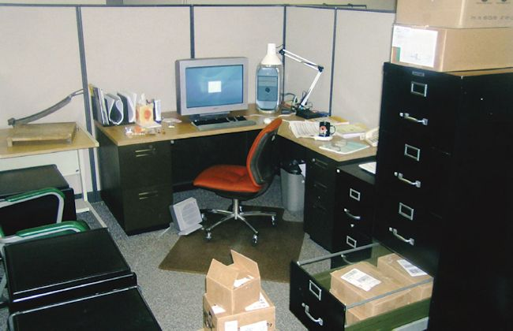
B=f(C)
Behavior is a function of the consequences (c) and past behavior (f)
In other words people will likely repeat things that give them positive outcomes.
Similarly they will be less likely to do things that result in negative outcomes
(or will be more careful not to get caught)

Slide 83
Behavior-Based Safety
… is a process that helps employees identify and choose a safe behavior over an unsafe one.
To use the 6 foot ladder they have or to get the 8 foot ladder they need!

Slide 84
The Behavior Based Safety Challenge
To create conditions that encourage people to collaborate because they want to not because they have to!
Notes:
23
Our challenge then is to go from a negative reinforcement environment to a positive reinforcement environment.
I am sure we would all like to see everyone at our workplace showing up for work because they want to, not because they have to just to receive a paycheck.
The more we can increase the amount of discretionary effort (positive effort that is not an essential function of the employee’s job) expended by employees, the more rapidly we can tap into the reservoir of human potential that often lies dormant in most companies.

Slide 85
Behavior-Based Safety Track Record
Has been implemented hundreds of thousands of times worldwide
90% of companies adopting BBS (Correctly) have continued with it
Average 5-year incident reduction (Based on a NSC Study):
62% Reduction of Incidents (FYI….This was the highest in the study)

Slide 86
Behavior-Based Safety Process Model
Identify “critical”work behaviors
Reinforcement and Feed Back
(+ or -)
Conduct periodic observations

Slide 87
1) Identify Critical Behaviors
Identity critical behaviors you want to focus on in your organization or even department
Protective Equipment (head/ eye protection)
Seat Belts
Gloves
Awkward Postures
Spotter when backing
And so on….

Slide 88
Create an Observation Form
A complete observation report should include the following information:
Any unsafe acts observed
Actions taken to encourage continued safe performance
Immediate corrective action
Actions taken to prevent recurrence

Slide 89
2) Conduct Periodic Observations to Monitor Behavior
Employees are observed performing their work
Feedback is provided about the observation
The observer documents both safe and unsafe behaviors

Slide 90
3) Reinforcement and Feedback
This is one of the most important (and hardest) components of the process
The employee is then provided positive feedback on the safe behaviors and non-threatening feedback on the unsafe behaviors
At risk behavior cannot be ignored

Slide 91
Keep in mind that….
…what the supervisor says and does and how he/she measures and rewards give workers signals as to what is important and what is not!

Slide 92
Formal Review of Observation Data
The data must be reviewed and analyzed to determine the employee’s (or department’s) improvement in safe behaviors
It can be looked at as an overall percentage.
Example: If 170 out of 200 employees observed were “all safe” then the overall behavior is 85% safe.

Slide 93
The FUTURE Florida Municipal Safety Excellence Initiative

Slide 94
A well-implemented health and safety management system will lead to a reduction in losses, injuries, and illness!

Slide 95
The Initiative “In a Nut Shell”
VOLUNTARY SAFETY ACCREDITATION PROGRAM
To become accredited you must meet established standards.
Will be scalable based on the size of the organization
Once accredited, the members will obtain various benefits including:
A “Certificate of Safety Excellence” aka CSE
Peer Recognition (press releases, awards banquets, etc.)
Additional safety grant funds
Other financial incentives

Slide 96
Overall Initiative Process:
Implement/improve Health and Safety Management System
Conduct Safety/Risk Improvement Assessment (level 1, 2, 3)
Obtain Certificate of Safety Excellence (level 1, 2, 3)

Slide 97
Five Core Management Processes:
Section 1: Commitment to Safety and Health (Safety policy, defined roles and responsibilities, etc)
Section 2: Organizational Emergency Readiness (Clear and effective emergency planning, drills, business continuity, etc)
Section 3: Organizational Incident and Claims Management (Clear and understood process, root cause analysis, transitional work)
Section 4: Organizational Performance Measurement (Internal measurements of safety/risk performance)
Section 5: Other Organizational Responsibilities (Drug free workplace, hostile workplace)

Slide 98
Departmental Safety Management:
Section 1: Management Commitment
Section 2: Performance Measurement
Section 3: Hazard Identification and Control
Section 4: Training
Section 5: Behavior Management
Section 6: Specific Safety Issues/Requirements (Technical stuff will be different based on the work they do)
Section 7: Emergency Response

Slide 99
Templates:
All programs will be provided in an online library of templates.
The templates will include:
Policies and processes for the 5 core elements
Written programs for the optional dept modules
Forms and other supporting documents
Safe work practices, best practices and hazard bulletins

Slide 100
Member Leadership Training:
Risk managers could take a series of in person and online courses to obtain a “FL Municipal Risk Manager Certificate”
Department leadership including directors and managers could take a series of in person and courses to obtain a “FL Municipal Safety Leadership Certificate”

Slide 101
Employee Training:
Will provide templated training materials for the internal trainers to use with their employees
Eventually these courses can be developed for online presentation as an individual or as a tool for group sessions

Slide 102
Public Recognition:
Many members have a healthy competition with their neighbors.
Press releases
Awards events
Magazine articles
Peer recognition

Slide 103
Session Review
A Brief Historical Look at Risk and Safety Management
Physical Hazards (Safety Inspections)
Physical Hazards (Incident Reporting and Investigation)
Managerial Tools (Understanding Risk Taking)
Managerial Tools (Performance Measurement)
Behavioral Tools (Behavioral Based Safety)
The Florida Municipal Safety Excellence Initiative

Slide 104
ANY QUESTIONS?

