Slide 1
Recruiting
The Battle for Talent
Jeffrey Ling, PhD
Evergreen Solutions, LLC
jeff@consultevergreen.com

Slide 2
Discussion
Our situation
Available Solutions
Maximizing Recruiting
Why candidates accept offers?
What is Employer Branding?
What can be done short and long-term?

Slide 3
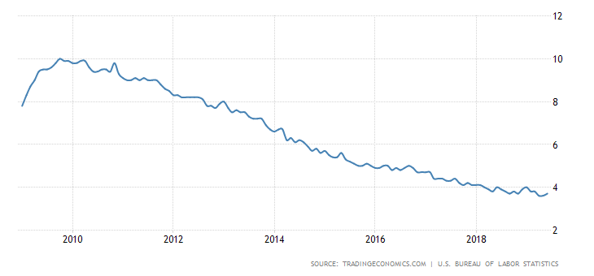
Unemployment - Supply
Unemployment is less than four percent on average
Less available candidates
Lower quality candidates
High quality candidates are strategic

Slide 4
Recruiting is Much Tougher
Forty-six (46) percent of U.S. employers report difficulty filling jobs, according to the Manpower Group 2018 Talent Shortage Survey of more than 2,000 U.S. employers.
Larger employers are having bigger issues than smaller employers.

Slide 5
Supply and Demand Pressure
Rank | Group
1 | Skilled trades (electricians, welders, mechanics)*
2 | Sales
3 | Engineers (civil)*
4 | Drivers (truck, delivery, commercial)*
5 | Technicians (quality, technical)*
6 | IT (cyber security, network, tech support)*
7 | Accounting and Finance (CPA, auditors, financial analyst)*
8 | Professionals (project mangers, lawyers, researchers)*
9 | Office support*
10 | Manufacturing

Slide 6
Solution Process
Identify Need
Determine Availability
Determine Source
Implement
Address Need

Slide 7
Determine Source
Source | Pro | Con
Develop and Promote | Align capabilities with needs Reduced overall cost Maintains culture | Risk of failure Long investment cycle Potential loss of potential candidate Potential turnover
Recruit | More responsive to time constraints External pool (experience, expertise) New ideas and approaches | Risk of failure Organizational learning curve Higher cost than internal Higher probability of mobility Cultural alignment issues
Outsource | Flexibility in staffing changes Larger pool of candidates Less administrative burden Focus on outcomes | Risk of failure Higher long term cost Lack of direct control Cultural alignment issues

Slide 8
Acceptance Factors
While generations may differ on the importance of an element, there are commonalities in the reasons for accepting offers.
Why a candidates accepts can be as important as why they leave.
Org
Culture
On-the-Job perks (childcare, flextime, telecommuting)
Job
Quality of work
Manager style
Opportunities
Career development (advancement)
Travel
Rewards
Compensation
Benefits
Values
Community service
Team
Location
Ongoing recognition
Work-Life balance
Other financial perks (credits, subsidies, bonuses)
Job security

Slide 9
Public Competitive Advantage
LIkely
Work-Life Balance
Benefits
Community Service
Possible
Culture
Location
Career Development
Management Style
Team Quality
Employee Recognition
On-the -Job Perks
Job Security
Unlikely
Compensation
Non-Salary Financial Perks
Travel

Slide 10
Employer Branding
Employer brand is a term referred to describe an organization's reputation and popularity from a potential employer's perspective and describes the values the company gives to its employees.
Employer Branding is the process of creating and maintaining your organization's Employer Brand.

Slide 11
Elements of Branding
Perceptions
Job Posting
Communicating
Branding

Slide 12
Perceptions
Perceptions are more important than ever with the degree of connectivity.
Make sure you have advocates: employees, candidates, and alumni.
Constantly leverage networks.
Develop and mine contacts.
Be serious about social media marketing.

Slide 13
Job Posting
Job postings accomplish the following:
Attract the right candidates
Repel the wrong candidates
Build/reinforce employment brand
Know the key answers to the following:
What is generally cool about your organization?
What is specifically cool about this job?
What would repel the right people?

Slide 14
The Marketing Part
Who are you targeting?
What do they value?
Where do they “hang out”?
Buzzwords
Background
Belief systems

Slide 15
Communicating
Focus on strengths (value proposition)
Embrace diversity in messaging and actions
Start a blog or other communication tool to establish image and narrative
Use multi-media to engage (our story)
Interact online

Slide 16
Major Steps
Become familiar with good and bad traits of your organization
Assess the employer brand
Define the value proposition
Do recruitment marketing (sell your organization)
Increase engagement among current employees
Have marketing focused job descriptions
Treat candidates like customers
Short-term
Long-term

Slide 17
Take Away
Positive imaging requires a comprehensive approach. You have to be out there in the real and digital worlds on a constant basis – the website is not enough.
Like it or not, employer branding starts and ends with your employees. Employees, candidates, and alumni all establish your brand.
It takes a whole organization to recruit the best workforce.
Shift from screening and verifying to selling to high value candidates.

