Slide 1
Leading and working in the aftermath: from panic to productivity
A Session from the No-Nonsense Post Pandemic Professional Development Training Series
Training Seminar with Coach Lisa
©2021 No-Nonsense Training Solutions, Inc.

Slide 2
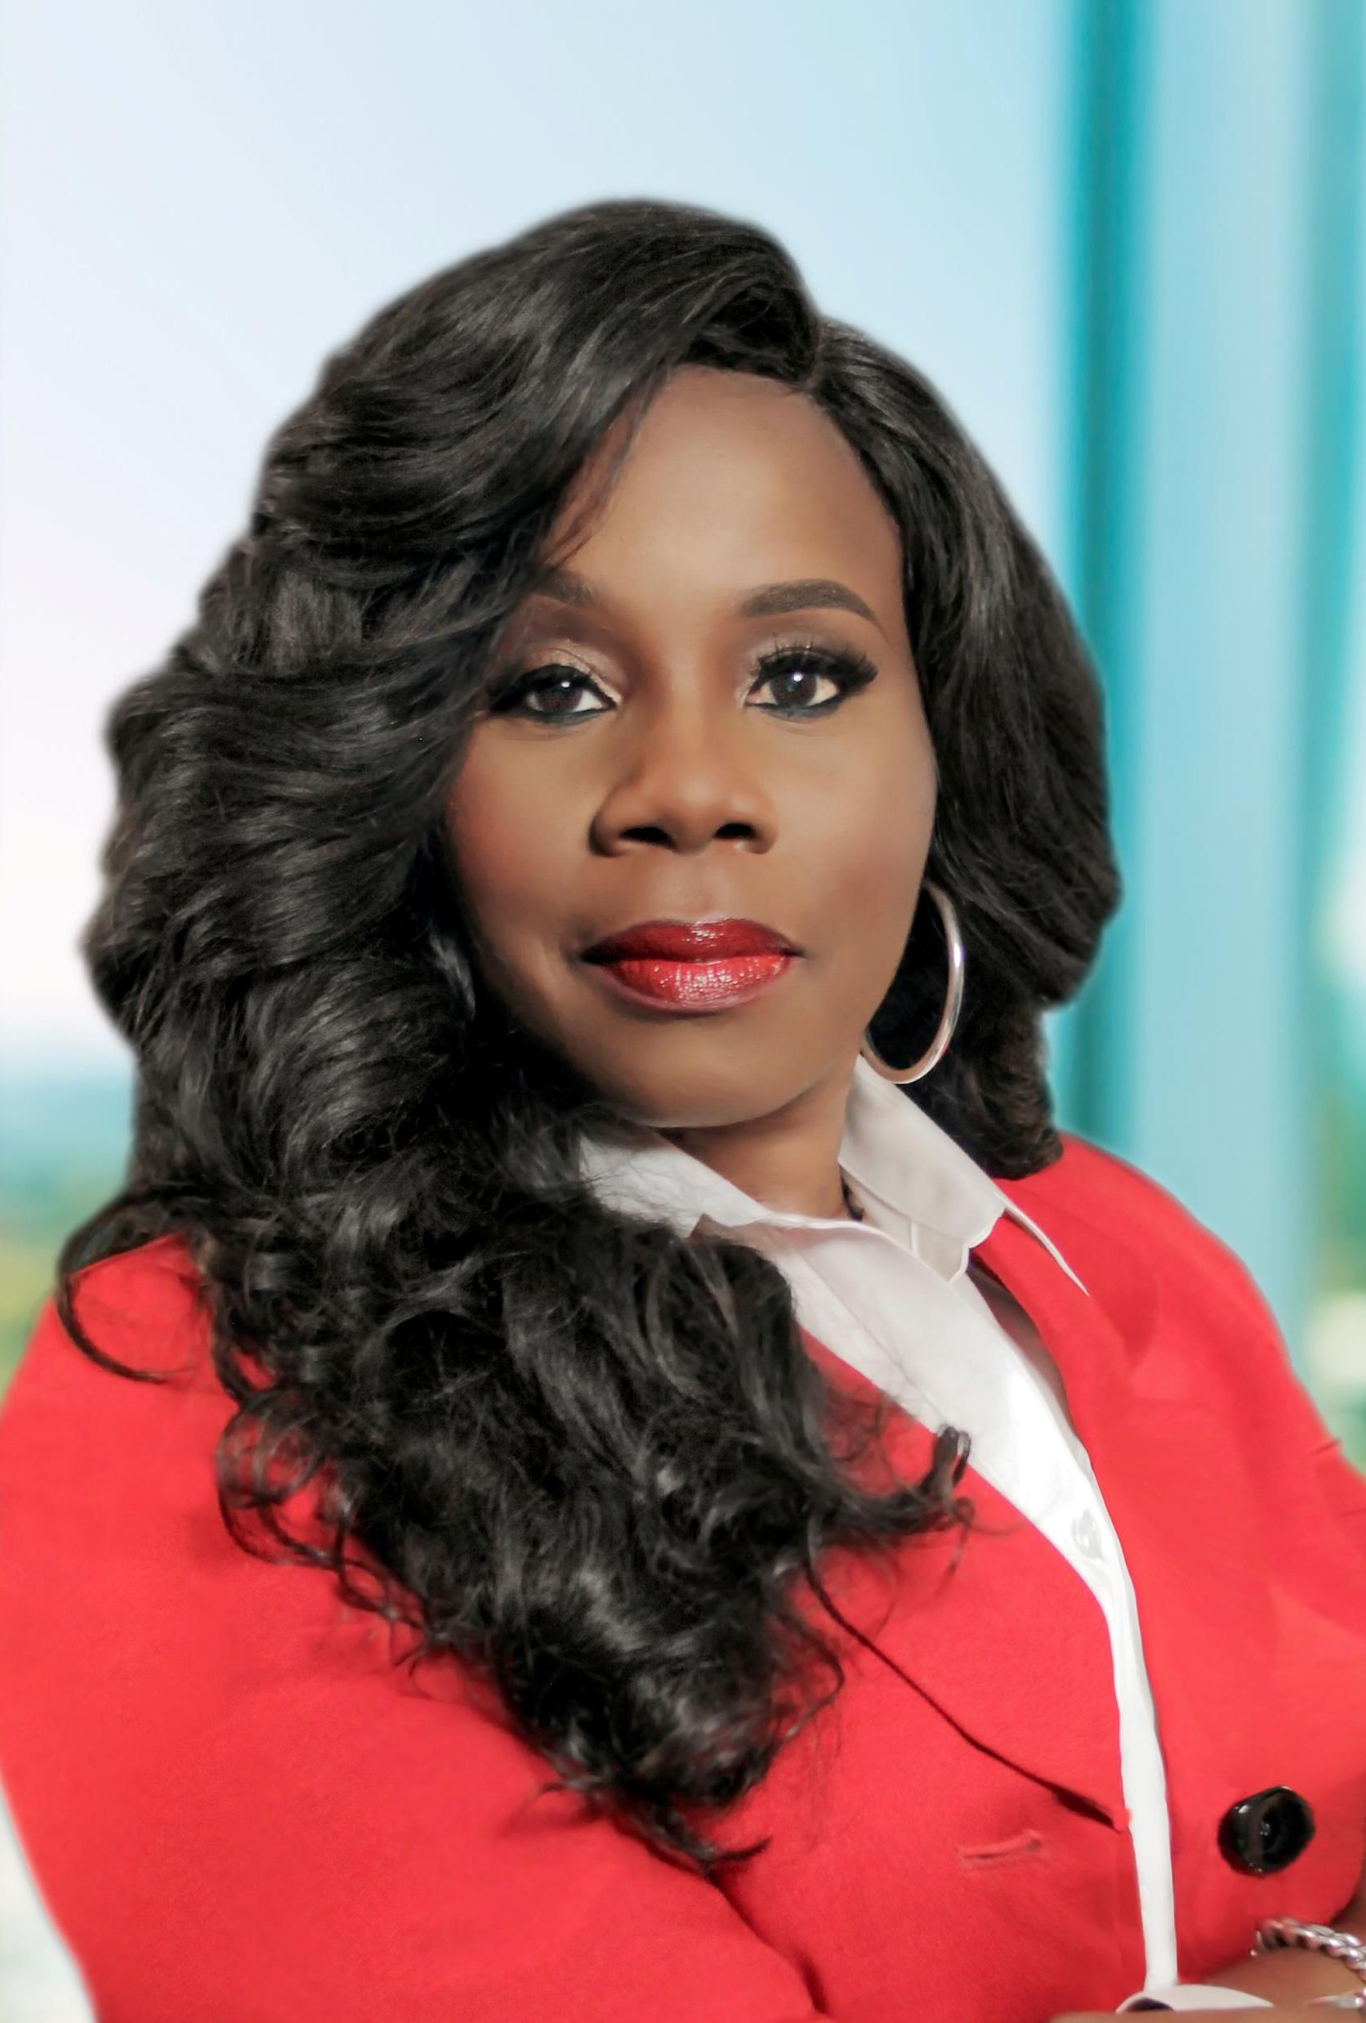
Who Am I?
CEO and Founder No-Nonsense Training Solutions
CEO and founder S.T.AN.D coaching services
Graduate - Florida State University
Strategic Solutions Specialist
ITW Certified General Instructor - FDLE
Strategic Leadership, Professional Development
&
Certified Master Life Coach
No-Nonsense Leadership Boot Camp Academy
International Keynote Conference Speaker
Director, Statesmen Leadership Institute – A Global Leadership Training Org.
Self-published author – “10 traits of Counterfeit Leadership: Recognizing the Fake, the Phony, the Fraudulent” Book and Coaching Kit
New Book “Navigating Through the F.I.R.E.S. OF LEADERSHIP: LEADING WHEN THE HEAT IS ON!”
Podcast:
“No-Nonsense Wisdom Wednesday with Coach Lisa”
Adjunct Professor – Police Academy-Broward College

Slide 3
What we will cover
During this virtual training session, we will have a high-level leadership conversation where we will discuss:
The reality and impact of our current global situation.
Several No-Nonsense Wisdom Truths to help participants navigate effectively in the workplace in the aftermath of the crisis.
The process of moving “From Panic to Productivity” and reviewing the strengths that we bring to the work environment.
©2021 No-Nonsense Training Solution, Inc.

Slide 4
Our current reality & global impact
Coming out of a Global Pandemic Situation
The Global and National Paradigm Shifts
Refocusing taking place in every facet of life
The push to change and continue to be productive
Organizations must adapt.

Slide 5
working in the aftermath
Aftermath – the consequences or aftereffects of a significant unpleasant event. The period that follows an unpleasant event or accident and the effects that it causes. The resulting impact of an unpleasant event.

Slide 6
No-nonsense wisdom truths
Let’s take a moment and review several No-Nonsense Wisdom Truths. As we review, please check off the ones that really “speak” to you.

Slide 7
Moving from panic to productivity
Let’s take some time to self-evaluate. There is a process to move from the mental and emotional place of panic to the stable place of productivity.

Slide 8
The journey to productivity
THE PANIC ZONE
THE PAUSE ZONE
THE PRODUCTIVITY ZONE

Slide 9
The Panic Zone - behaviors
Panic fuels and drives negative emotions.
Panic provokes fearful unproductive behavior
Panic allows complaining to become the norm.
Panic produces anger that you rely on to get things done.
Panic increases unnecessary hoarding behavior.
Panic increases denial and resistance.
Panic seeks out the negative to keep you “inspired”.
Panic allows depression and fear to stop you completely.
Panic increases unnecessary eating, drinking, and other forms of unhealthy behavior.
Panic makes way for the isolating thoughts to take over.

Slide 10
The Pause Zone
Pause allows you to recognize and begin to halt the negative emotions.
Pause makes you consider your behavior.
Pause before complaining. It could be worse!
Pause and see if your anger is valid or not.
Pause to refocus on what you control.
Pause allows you to explore the possibilities.
Pause to reflect on what you are resisting and denying
Pause to speak positive to the negative.
Pause and consider the negative info being consumed and shared.
Pause to respond effectively.
Pause and choose to remember you are not alone.
Pause allows for you to regroup, reevaluate, and recommit.

Slide 11
The productivity Zone
Productivity allows goals to be met.
Productivity opens up a new flow of creativity.
Productivity moves us to new and innovative ideas.
Productivity “wakes up” those around you to be productivity.
Productivity energizes the team to do more because they see right outcomes.
Productivity inspires greater ideas.
Productivity allows you the ability to collaborate more effectively with your team.
Productivity pushes you to look for solutions for the new normal which makes you successful.
Productivity allows you to see and draw on the strengths around you.
Productivity resets the focus and creates forward momentum for success.
Productivity mindset gives you the ability to know how to professionalize conflict.

Slide 12
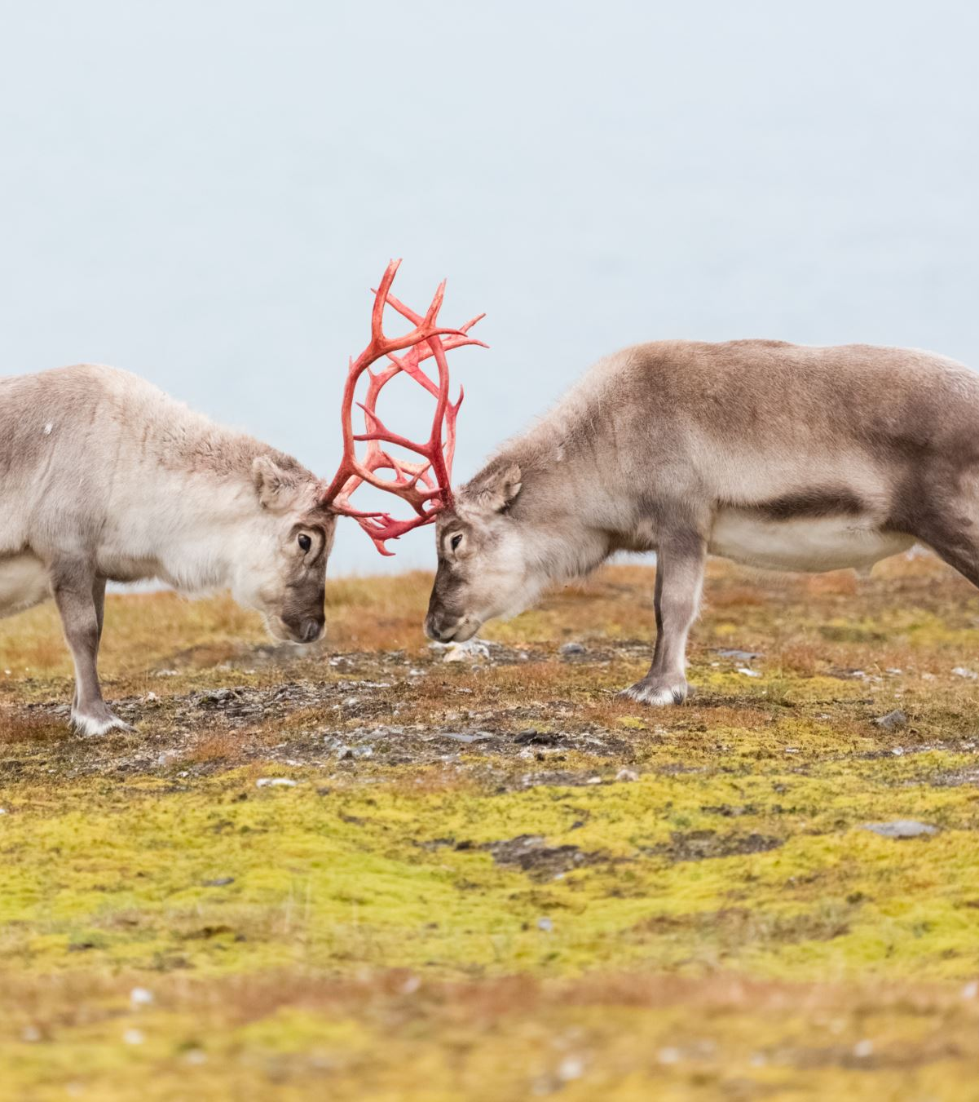
Professionalizing Conflict

Slide 13
CONFLICT
WHEN YOU HEAR THE WORD “CONFLICT” WHAT WORD COMES TO MIND?

Slide 14
Critical conflict resolution Best practices
A Crucial Conversation is defined as a discussion between two people in which:
Stakes are high.
Opinions may vary.
Emotions run strong.

Slide 15
Four AREAS to professionalize conflict 1. goals
These are the things that we are trying to attain.
These are things that we have established that we are trying to accomplish
Goals must be understood and agreed upon by everyone and everyone is trying to achieve the same goal.
If goals are misunderstood or not agreed upon you will have conflict.
When professionalizing conflict, you must ensure that the GOALS are understood and agreed upon.

Slide 16
Four AREAS to professionalize conflict 2. roles
This is what every individual is responsible for doing in helping us attain the established goals.
Does everyone understand what part they play in accomplishing these goals?
If roles are not clearly defined and clarified you will have overlap which will lead to conflict.
When professionalizing conflict, you must ensure that everyone understands their ROLES and responsibilities.

Slide 17
Four AREAS to professionalize conflict 3. procedures
These are the things that are in place to tell us how things should be done.
These are the things in place to tell us how things are to be communicated.
Procedures tell us how resources are to be used and deployed so that every member knows what is available in order to reach the goal.
When procedures on missing, not in place, not communicated or are incomplete you will have conflict.
When professionalizing conflict, you need to ensure that procedures are im place, that they are clear and understood.

Slide 18
Four AREAS to professionalize conflict 4. expectations
Set in place what is expected from everyone on the team to help us achieve the goal.
Helps hold everyone on the team accountable to the goal we are trying to achieve.
When expectations are misunderstood or not agreed with, you will have conflict.
When professionalizing conflict, you must ensure that everyone is clear on the expectations that have been established.

Slide 19
Strength to successfully navigate the aftermath
Understanding your strengths will have you get productive and stay productive in the aftermath.
Knowing your strengths helps you to provide greater value to your organization.
Recognizing your strengths helps you see places where you need to grow and develop.
If you overuse your strengths, they can become limitations for you in the “new normal.”

Slide 20
BEHAVIORAL ASSESSMENT
Leading in Times of Crisis
Your Strength in Tough Times

Slide 21
BEHAVIOR & CONFLICT ASSESSMENT STYLE
CHARGER STRENGTH
PERSUADER STRENGTH
STABILIZER STRENGTH
THINKER STRENGTH

Slide 22
We’re done!!!
Any questions or comments?

Slide 23
Thank you for participating!!!
Email: coachlisa@nonontraining.com
Website: www. nononsensetrainingsolutions.com
Office: 954-364-8871
Please like our Facebook Page: No-Nonsense Training Solutions
#COACHLISAGILBERT
IG: @COACHLISAGILBERT
“NO-NONSENSE WISDOM WEDNESDAY WITH COACH LISA” PODCAST

