Slide 1
Florida Public Human Resources Association
What’s New at the EEOC, DOL and FCHR?
July 24, 2021

Slide 2
Presented by:
Janet Goldberg McEnery
Shareholder
Board Certified Labor & Employment Law
Direct Number: (813) 222-5037
Email: jmcenery@stearnsweaver.com
www.stearnsweaver.com
Stearns Weaver Miller offers these educational and informational materials for the use of its clients and friends. These materials are not a substitute for legal advice. If you have any questions concerning these materials as they relate to your business, please contact your employment attorney.

Slide 3
INTRODUCTION
What’s New at the EEOC, DOL and FCHR?
Everything and Nothing….!

Slide 4
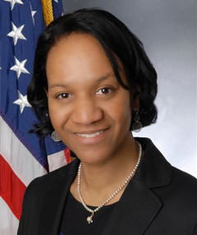
EEOC
Leadership changes
Full 5 members
Charlotte Burrows and Jocelyn Samuels appointed Chair and Vice Chair

Slide 5
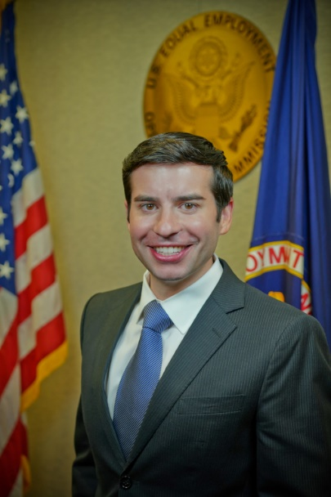
EEOC
Leadership changes
https://www.stearnsweaver.com/practices/breaking-through-the-noise/ Timestamp: 6:31 – 18:08
Keith Sonderling, EEOC Commissioner

Slide 6
EEOC
Priorities: New and Old
Strategic Enforcement Plan expires 2021
Janet’s Top 6 Picks
Expect to see strengthening of the protections against discrimination to LGBTQ community members.

Slide 7
EEOC
Priorities: New and Old
Expect to see more protections afforded to pregnant workers
Pregnant Workers Fairness Act (PWFA)

Slide 8
EEOC
Priorities: New and Old
Expect to see wage equity initiatives, including addressing perceived gender-based and race-based pay discrimination; also equal pay for people with disabilities.
Expanding a federal ban limiting employees’ ability to discuss salary.
Expanded prohibitions against salary history inquiries

Slide 9
EEOC
Priorities: New and Old
Expect to see expanded attention to race equity initiatives
More efforts at gathering data.
Expect to see a revisit of religious discrimination compliance manual.
Expect to see the same enforcement and emphasis on protecting the rights of the disabled and preventing sexual harassment.

Slide 10
EEOC
Priorities: New and Old
Reducing backlog
Veterans outreach a priority under prior administration

Slide 11
EEOC
Conciliation Changes
Mid-February, 2021 EEOC implemented a new, improved, revamped Conciliation Program
After a “cause” finding, EEOC must pursue conciliation, prior to filing a lawsuit.

Slide 12
EEOC
Conciliation Changes
Under the new program, employers were entitled to a more detailed explanation.
EEOC would have had to provide a written summary of known facts and information.
Also the EEOC was required to provide its legal basis in writing and a calculation of monetary relied sought.

Slide 13
EEOC
Conciliation Changes
Joint resolution from Congress signed by the President, providing that the EEOC’s revised conciliation rules have “no force or effect”.

Slide 14
EEOC
EEOC data collection will resume shortly
It was temporarily suspended 5/20

Slide 15
EEOC
EEOC Launched a New Systematic Enforcement Webpage
Provides examples of practices that can lead to systematic claims
Criminal/credit background checks
No rehire of retired workers, and/or hiring of currently employed individuals only

Slide 16
EEOC
EEOC Launched a New Systematic Enforcement Webpage
Layoffs, reorganizations and RIFs
Waivers that do not comply with OWBPA
Light duty policies limited to work-related injuries

Slide 17
EEOC
EEOC Launched a New Systematic Enforcement Webpage
Describes the steps the EEOC takes to investigate these claims
Including use of data obtained from annual EEO reports

Slide 18
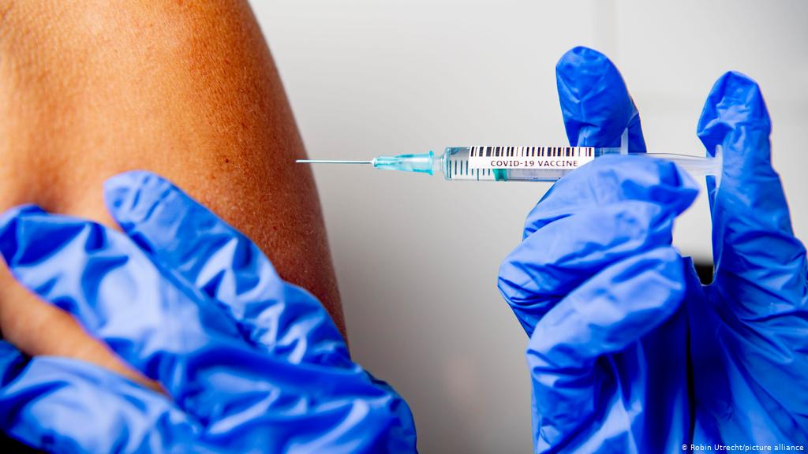
EEOC
EEOC’s Position on COVID-19 Vaccine Mandates and Incentives
How many employers have required employees to confidentially report their vaccine status?
>75%
>85%
>95%
What did you learn?

Slide 19
EEOC
COVID-19 Vaccine Mandates and Other COVID-19 Related Issues
Privacy Issues
Employees who want to permanently work from home
Dust off your ADA Interactive discussion procedures
What about using incentives to get people vaccinated?

Slide 20
EEOC
COVID-19 Vaccine Mandates and Other COVID-19 Related Issues
What about masks?
Is the CDC correct?
What about employees who refuse to wear them?

Slide 21
EEOC
The Future of Dress Code Policies
Old Rules
What is a gender-neutral dress code?

Slide 22
EEOC
The Future of Dress Code Policies
N.W. Airlines adopted a uniform policy requiring flight attendants to pick either a male or female uniform.

Slide 23
EEOC
The Future of Dress Code Policies
Lawsuits over hairstyles: dreadlocks

Slide 24
EEOC
Sex Harassment Settlements
EEOC will keep a close eye on settlement agreements involving harassment allegations.
Confidentiality is disfavored.
What about no-rehire?

Slide 25
EEOC
Opioid Addiction and Other ADA Issues
Use of Codeine, Oxycodone, and other Opioids: Information for Employees.
Can an employee be fired for the legal use of opioids?
How Health Care Providers Can Help Current and Former Patients ….Stay Employed

Slide 26
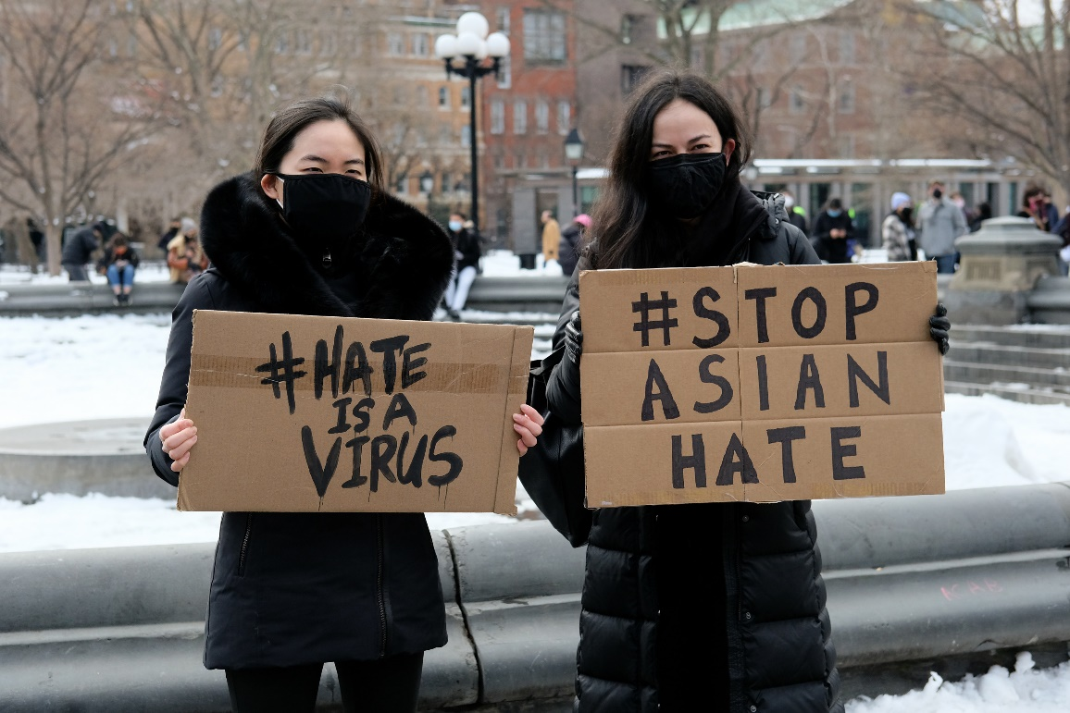
EEOC
Expect to See the EEOC Address Rise in Asian-American Discrimination

Slide 27
EEOC
Rethinking Religious Discrimination
Boystock v. Clayton County, recognizing LGBTQ+ employees are protected.
Title VII protects employees’ “sincerely held religious beliefs” but also protects employees from gender identity/transgender status and sexual orientation discrimination.
“Undue hardship” has lower burden than under ADA.

Slide 28
EEOC
Rethinking Religious Discrimination
BALANCE
Examples

Slide 29
EEOC

Slide 30
DOL
DOL Leadership Changes
Secretary of Labor – Marty Walsh
Deputy Secretary – Julie Su
New Solicitor
Administrator of Wage and Hour Division – Nominee David Weil

Slide 31
DOL
DOL Leadership Changes
Expect to see more protections for workers and an expansion of who is covered.

Slide 32
DOL
Minimum Wage, Overtime and Exemptions
Under this new proposal, beginning January 30, 2022, Government Contractors to the private sector would be required to pay a minimum of $15 an hour on new or extended contracts.
Public comment period.

Slide 33
DOL
Minimum Wage, Overtime and Exemptions
Move to increase salary threshold
Currently $35,568
Proposed increases include one for $85K
Will DOL also tweak the duties test?

Slide 34
DOL
Minimum Wage, Overtime and Exemptions
Florida voted to increase the minimum wage from $8.56 to $10 an hour in September 2021.
$1 an hour increase every year thereafter until it reaches $15 an hour.

Slide 35
FCHR
Leadership Changes
New Director – Cheyanne Costilla
Chief of Investigations – Jacquelyn Dupree

Slide 36
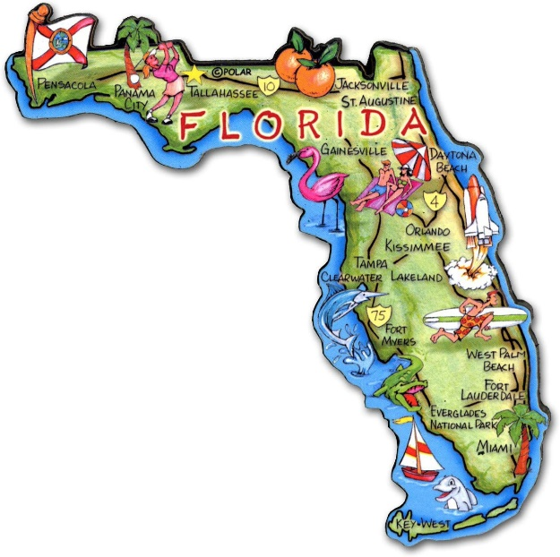
FCHR
February 2021, Florida Commission on Human Relations affirmed that FL state law prohibiting discrimination on the basis of “sex” also protects LGBTQ people from discrimination.
Second state in the South to do so.

Slide 37
FCHR
Florida Civil Rights Act of 1992 amended to change the time period by which a Plaintiff must file a lawsuit.

Slide 38
FINAL WORDS – PRACTICAL TIPS
Consider practice risk assessments: Review policy, pay practices, selection criteria.
Keep alert to changes and developments.
Because of the emphasis on prosecuting systematic cases, exercise care in responding to EEOC Charges.

Slide 39
FINAL WORDS – PRACTICAL TIPS
Develop quantitative metric to track applicants, education, training and experience to ensure pay disparities are based on such metrics.
Consider how the minimum wage changes will affect your company.

Slide 40
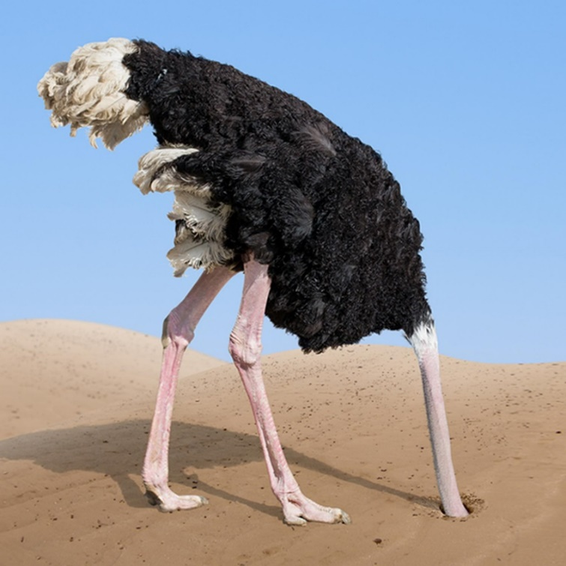
QUESTIONS?

Slide 41
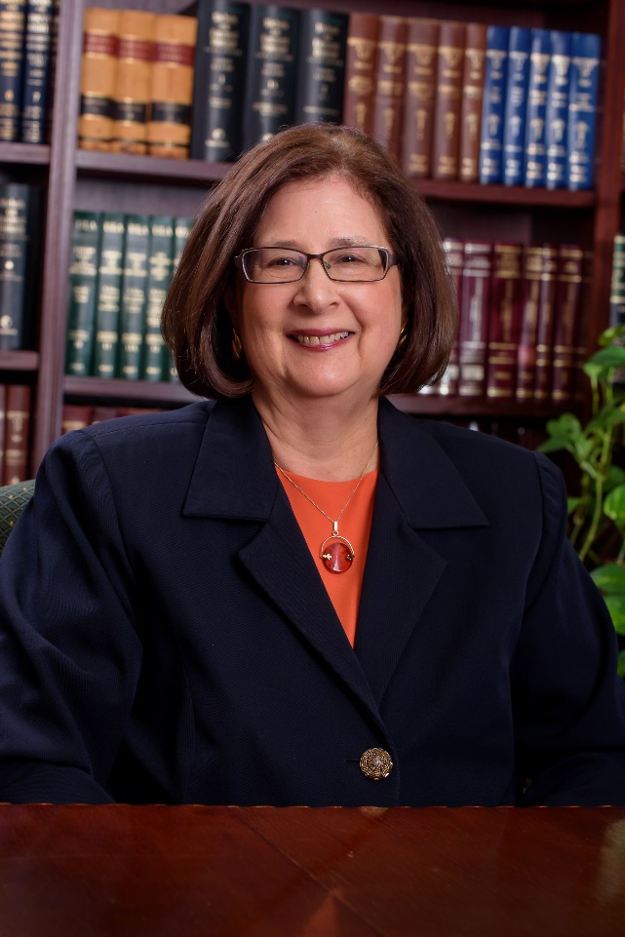
Janet Goldberg McEnery
Direct: (813) 222-5037
Email: jmcenery@stearnsweaver.com
Janet Goldberg McEnery is a Shareholder with Stearns Weaver Miller in its Labor and Employment Law section. Ms. McEnery is Board Certified by The Florida Bar in Labor and Employment Law and has been recognized by her peers in Best Lawyers® in America, as a Florida Super Lawyer®, and in Florida Trend’s “Legal Elite” for Labor and Employment Law. She is licensed in Florida, Illinois and Missouri. Ms. McEnery received her B.A., magna cum laude, from S.U.N.Y. Buffalo and her J.D. from the University of Illinois, College of Law. She formerly served as a trial attorney and acting supervisor for the National Labor Relations Board.

