Slide 1
D
D
What We All Want!
(To Feel Valued and Respected)
Diversity / Sexual Harassment Prevention
Training
What We All Want!
(To Feel Valued and Respected)
Diversity / Sexual Harassment Prevention Training
davidalba007@gmail.com

Slide 2
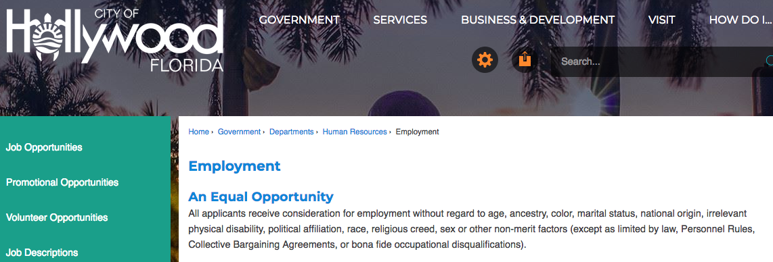
Your City Takes “No Discrimination” and “No Harassment” Seriously
City Policy: HR-026 EQUAL EMPLOYMENT OPPORTUNITY

Slide 3
Village of Pinecrest Takes No Discrimination and No Harassment Seriously
Your City Takes “No Discrimination” and “No Harassment” Seriously
HR-028 SEXUAL HARASSMENT PREVENTION POLICY

Slide 4
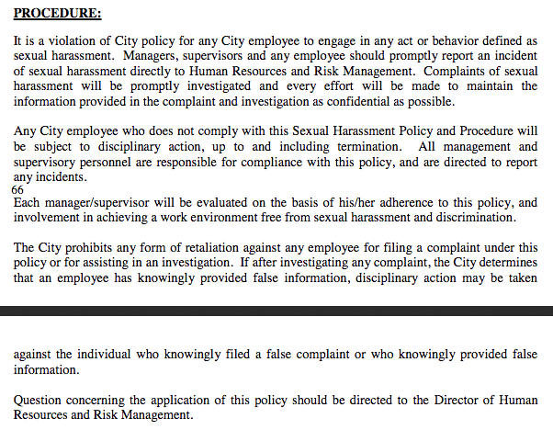
Village of Pinecrest Takes No Discrimination and No Harassment Seriously
Your City Takes “No Discrimination” and “No Harassment” Seriously
See it – report it!

Slide 5
Defining Our Terms
Defining Our Terms
Diversity: similarities and differences among employees in terms of age, cultural background, physical abilities and disabilities, race, religion, sex, and sexual orientation.

Slide 6
Defining Our Terms
Defining Our Terms
Sexual Harassment: unwelcome sexual advances, requests for sexual favors, and other verbal or physical conduct of a sexual nature.

Slide 7
Defining Our Terms
Overriding Principle
All people want to feel:
Valued and respected

Slide 8
Major Federal EEO Laws
Major Federal EEO Laws
Title VII – The Civil Rights Act of 1964
Civil Rights Act of 1991
Age Discrimination in Employment Act of 1967
Equal Pay Act of 1963
Americans with Disabilities Act of 1990 (Title I)

Slide 9
Major Federal EEO Laws
Major Federal EEO Laws
Title VII – The Civil Rights Act of 1964
Prohibits discrimination of employment based on race, color, religion, sex or national origin
Unlawful to discriminate in:
Job advertising
Recruitment
Selection
Assignment
Transfer
Classification
Promotion
Wages
Salary
Discipline
Training
Seniority
Benefits
Layoffs
Recall
Termination

Slide 10
Major Federal EEO Laws
Major Federal EEO Laws
Civil Rights Act of 1991
Established right to jury trials for EEO litigation
Pregnancy Discrimination Act of 1978 is an amendment to Title VII

Slide 11
Major Federal EEO Laws
Major Federal EEO Laws
Age Discrimination in Employment Act of 1967
Prohibits employment discrimination against individuals over 40

Slide 12
Major Federal EEO Laws
Major Federal EEO Laws
Equal Pay Act of 1963
Equal pay for equal work
Applies to pay disparities between men and women
Applies to all payments and benefits given to employees

Slide 13
Major Federal EEO Laws
Major Federal EEO Laws
Americans with Disabilities Act of 1990 (Title I)
Prohibits discrimination against qualified individuals with disabilities
Duty to engage in “interactive process”
Duty to reasonably accommodate unless undue hardship
Notes:
.

Slide 14
Important Supreme Court Cases
Important Supreme Court Cases
Griggs v. Duke Power Company (1972)
Adverse impact on selection criteria – tests, degrees, etc.
Uniform guidelines on employee selection criteria
Criteria must be job-related and consistent with business necessity
Bona Fide Occupational Qualification
(Race is never a BFOQ)

Slide 15
Important Supreme Court Cases
Important Supreme Court Cases
Meritor Savings Bank v. Vinson (1986)
Unwanted sexual advances can create a hostile working environment
Title VII covers not just quid pro quo sexual extortion but also hostile or abusive workplace

Slide 16
Important Supreme Court Cases
Important Supreme Court Cases
Faragher v. Boca Raton; Ellerth v. Burlington (1998)
Employer is vicariously liable for action of supervisors
If tangible action taken (quid pro quo): There’s no defense
If no tangible action taken in harassment: Employer may have affirmative defense if it can show reasonable measures:
Anti-harassment policy distributed to all / EEO education / prompt and effective corrective action
Complainant failed to take advantage of complaint process

Slide 17
Kinds of Discrimination
Kinds of Discrimination
Disparate Treatment
Disparate (Adverse) Impact
Sexual Harassment
Quid Pro Quo - this for that
Hostile Work Environment
- Harassment creates an environment where the individual feels intimidated or the environment is offensive and interferes with their ability to perform on the job
- Conduct is severe or pervasive
- Subject to the reasonable person standard

Slide 18
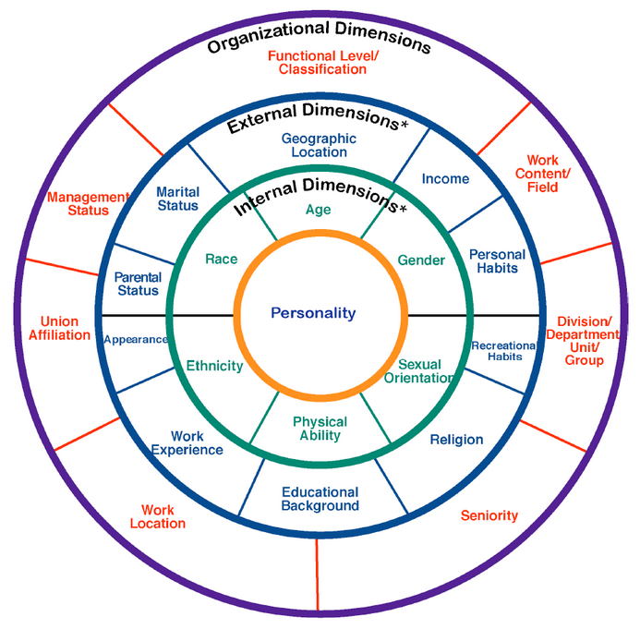
Diversity Wheel

Slide 19
Importance of Understanding
Diversity and Sexual Harassment Prevention
For Employees | For Our Village
To gain diverse ideas
To feel valued
To gain diverse
knowledge
To feel respected
To feel included
To understand diverse
customs
So he/she can
contribute their best
So we can better serve
a diverse customer base
and work harmoniously

Slide 20
Factors of Diversity
Seen | Not Seen (discovered)
________________
________________
________________
________________
________________
________________
________________
________________
Etc.
Etc.
These factors affect our worldview.

Slide 21
Worldview
(various definitions)
The overall perspective from which one sees and interprets the world.
A theory of the world, used for living in the world.
How one interprets reality.
Our “normal”

Slide 22
Different Worldview
We may think they’re rude!
We may think they’re odd.
We may confuse their intentions.
So we might exclude them, dismiss their contribution, and/or disrespect them.

Slide 23
Which One Are You?
Generational Differences
Generational Timeline
1946-1964 | 1965-1980 | 1981-2000
Baby Boomers | Generation X | Millennials

Slide 24
4 Key Areas
Elements that Shape Our Ability to Manage Diversity and Prevent Sexual Harassment
Knowledge
Understanding
Acceptance
Behaviors

Slide 25
Knowledge
Generalizing vs. Stereotyping
Generalizing | Stereotyping
Retained consciously
Retained unconsciously
Descriptive, not judgmental
Judgmental, not descriptive
Modified by
subsequent experience
Not modified by experience

Slide 26
Knowledge
Generalizing vs. Stereotyping
Generalizing | Stereotyping
Grouping elements to form
logical categories to make
sense of a complex world
Categorizing people as a group,
ignoring individual differences
Western societies tend to be
individualistic
Australians are selfish
Germans tend to value
efficiency and formality
Germans are uptight
U.S. Americans praise personal
achievement
Americans are show-offs
Japanese society values
discretion and politeness
Japanese never say what they
really think

Slide 27
Understanding
To gain further understanding we can prepare our minds by:
Keeping an open mind about others
Avoid seeming judgmental or forming an opinion about others based on:
What they look like
What others have said about them
Our personal biases

Slide 28
Acceptance
Of Ourselves | Of Others
I can ask myself:
There may be more than
one acceptable behavior
Do my actions show value
for others?
Find commonalities
Are my actions stemming
from respect for others?
Celebrate differences
If we disagree, we can agree
to disagree, agreeably
You won’t hate anyone to
your point of view

Slide 29
Behaviors
The way we interact with others.
It’s our behaviors that manifest our:
Knowledge
Understanding
Acceptance
One of our most fundamental
behaviors is our communication!

Slide 30
Basic Elements of Communication
Verbal Behavior
Non-verbal Behavior
Values and Attitudes

Slide 31
Communication
Verbal Behavior – what we say and how we say it
Keep it professional
Careful with idioms and slang
That’s the Cadillac!
It only cost 2 bucks.
You hit a home run with that one!
A phrase we all should know:
I am not comfortable with this – Stop!

Slide 32
Communication
Non-verbal Behavior – what we communicate in addition to words
Body language
Voice tone – no YELLING
Touching
Object language
Clothing
Adornment

Slide 33
Communication
Values and Attitudes– what we believe is right or permissible
Beliefs and feelings
Ethics and standards

Slide 34
Applying EEOC In Workplace Leader’s Responsibility
Legal duty to respond to harassment
Be proactive; monitor workplace behaviors, walk the talk, enforce respect for each other, avoid borderline
Treat all complaints seriously, confidentially
Take prompt action; investigate
Ensure no retaliation
Report complaints to HR
Take corrective action, follow-up
Document, Document, Document

Slide 35
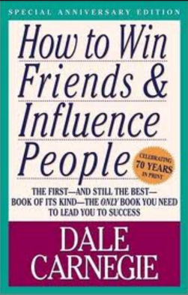
Thank You
My name is David Alba – davidalba007@gmail.com
On the eval, 1 is Poor and 5 is Excellent.
If any of my stories aren’t true - they should’ve been!
Three books I recommend:

