Slide 1
FLORIDA PUBLIC HUMAN RESOURCES ASSOCIATION
Florida's Resource for Public-Sector Human Resources...
Log in
Home
About►
Membership►
Resources►
Connections►
Events►
Certification
Job Board
CONFERENCE LOCATION
Hyatt Regency
Coconut Point Resort & Spa
5001 Coconut Road, Bonita Springs, Florida 34134
Phone: 239-444-1234
HOTEL INFORMATION
Preliminary Room Rate: $189.00 per night
Resort Fee: Included in your room rate
The resort fee will appear on your hotel reservation and will be removed at check-in.
Online Reservation Link:
https://www.hyatt.com/en-US/group-booking/NAPRN/G-GFLR
pureblack.de
SPONSORS & EXHIBITORS
Sponsorship & Exhibitor Registration Links:
2019 Sponsorship & Exhibitor Packages
2019 Sponsorship & Exhibitor Registration & Payment Link
Sponsors & Exhibitors-Additional Social Event tickets
Sponsorship _ Exhibitor Check Payment Form.pdf
CONFERENCE REGISTRATION
Online Registration Links:
2019- 83rd Annual FPHRA Pre-Conference
2019- 83rd Annual FPHRA Conference
2019 Conference - Guest Ticket-Tuesday Night Dinner Dance
AGENDAS
Pre-Conference at a Glance - 2019.pdf
Conference at a Glance - 2019.pdf
HOST COMMITTEE CHAIR
2018 Conference
2017 Conference
2016 Conference
2015 Conference
83rd Annual
FPHRA Conference
HOME - ABOUT - JOIN - RESOURCES
Questions? Contact the Webmaster

Powered by Wild Apricot Membership Software
July 22, 2019 Karen M. Morinelli, Tampa, Fl.
labor & Employment

Slide 2
This IS . . . . .
Labor & Employment

Slide 3
Potpourri |  | EEOC/ FCHR | In The News | Contract “Terms”
100 | 100 | 100 | 100 | 100
200 | 200 | 200 | 200 | 200
300 | 300 | 300 | 300 | 300
400 | 400 | 400 | 400 | 400
500 | 500 | 500 | 500 | 500

Slide 4
Potpourri – 100
In FY 2017 this Federal Agency received 84,254 charges and resolved 99,109.
Notes:
_

Slide 5
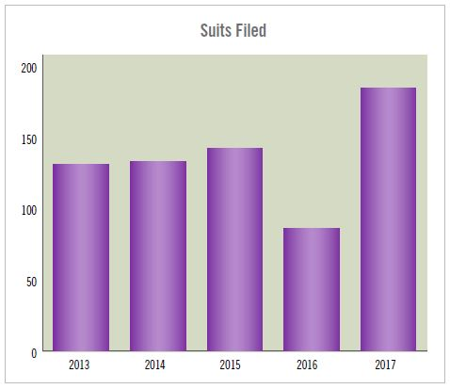
Answer
What is the EEOC?

Slide 6
Potpourri – 200
Next year it will fall on
March 31, 2020

Slide 7
Answer
What is
“Equal Pay Day”?

Slide 8
Potpourri – 300
This product is poised to be
a multibillion-dollar
industry in the state of Florida.

Slide 9
Answer
What is hemp?

Slide 10
Potpourri – 400
This federal agency’s
popular “opinion letters”
made a comeback after a
7 year absence.

Slide 11
Answer
What is the
U. S. Department of Labor?

Slide 12
Potpourri – 500
From 1933 to 1945 she served as the fourth Secretary of Labor and the first woman to hold the position.

Slide 13
Answer
Who was
Frances Perkins?

Slide 14
#! – 100
This movement was
founded in 2006 to help survivors of sexual violence and was revitalized in 2017.

Slide 15
Answer
What is the
#metoo movement?

Slide 16
#! – 200

Slide 17
Answer
Who is
Ronan Farrow?

Slide 18
#!– 300
This social media platform
recently settled 3 lawsuits and 2 complaints of “discrimination” in its advertising practices.
Notes:
This is Why You Should Never Shop on Amazon Without Using This Trick
Honey
You Should Never Shop on Amazon Again After Seeing This Site
Tophatter
The App Millennials and Gen X'ers Are Using to Learn a Language in 21 Days
The Babbel Magazine
20 Diabolical April Fools Pranks Guaranteed to Make You Giggle
Trendchaser
Personalize This Content
Quantcast
Most Popular
1
Disneyflix Is Coming. And Netflix Should Be Scared.
Derek Thompson
No company has been more responsible for shaping the modern entertainment landscape than Walt Disney. In 1937, with Snow White and the Seven Dwarfs, its first feature film, Disney invented the family blockbuster. In 1954, with Disneyland, an anthology series hosted by Walt Disney himself, it became the first movie studio to strike out for the wild west of television. Since then, Disney’s dominance has only grown. Of the dozen films with the largest worldwide box-office take since 2010, Disney released eight.
Those successes, however, belie real danger on the horizon for Disney. In recent years, many of the company’s traditional strengths have slowly turned into weaknesses—like a fairy-tale castle gradually flooded by its own moat.
Continue Reading
2
Partial skeleton remains from an ancient burial site
Was There a Civilization On Earth Before Humans?
Adam Frank
It only took five minutes for Gavin Schmidt to out-speculate me.
Schmidt is the director of NASA’s Goddard Institute for Space Studies (a.k.a. GISS) a world-class climate-science facility. One day last year, I came to GISS with a far-out proposal. In my work as an astrophysicist, I’d begun researching global warming from an “astrobiological perspective.” That meant asking whether any industrial civilization that rises on any planet will, through their own activity, trigger their own version of a climate shift. I was visiting GISS that day hoping to gain some climate science insights and, perhaps, collaborators. That’s how I ended up in Gavin’s office.
Just as I was revving up my pitch, Gavin stopped me in my tracks.
Continue Reading
3
Why American Students Haven't Gotten Better at Reading in 20 Years
Natalie Wexler
Every two years, education-policy wonks gear up for what has become a time-honored ritual: the release of the Nation’s Report Card. Officially known as the National Assessment of Educational Progress, or NAEP, the data reflect the results of reading and math tests administered to a sample of students across the country. Experts generally consider the tests rigorous and highly reliable—and the scores basically stagnant.
Math scores have been flat since 2009 and reading scores since 1998, with just a third or so of students performing at a level the NAEP defines as “proficient.” Performance gaps between lower-income students and their more affluent peers, among other demographic discrepancies, have remained stubbornly wide.
Continue Reading
4
How Syria Came to This
Andrew Tabler
Seven years of horrific twists and turns in the Syrian Civil War make it hard to remember that it all started with a little graffiti.
In March 2011, four children in the southern city of Der’a scrawled on a wall “It’s your turn, Doctor”— a not so subtle prediction that the regime of Syrian President Bashar al-Assad, a British trained ophthalmologist and self-styled reformer, would go down in the the manner of the Ben Ali regime in Tunisia, the Mubarak regime in Egypt, and eventually, the Qaddafi regime in Libya. But Syria’s story would turn out differently.
The crackdown started small. Assad’s security services arrested the four graffiti artists, refusing to tell their parents where they were. After two weeks of waiting, the residents of Der’a—who are famously direct and fiery—held protests demanding the children’s release. The regime responded with live gunfire, killing several, and drawing the first blood in a war that’s now killed some half a million people. With every funeral came more opportunities for protests—and for the regime to respond with more violence.
Continue Reading
5
Neither Precise Nor Proportionate
Eliot A. Cohen
“Precise and proportionate,” is how Secretary of Defense James Mattis described the recent shower of missiles that fell on three targets in Syria. Precise, possibly, although anyone who has dealt with them knows that smart weapons often do dumb things. But proportionate? On that one we should trust the words of poets, not generals:
Avenge! No such revenge - revenge for
the blood of a little child - has yet been
devised by Satan.
Thus wrote Chaim Nahman Bialik after the Kishinev massacre of 1905. Proportionality, in this case, would require asphyxiating Bashar al-Assad’s children slowly with chlorine gas, and making sure that the world knows about it. We do not do such things.
What did we do, instead? “We believe that by hitting Barzeh in particular we've attacked the heart of the Syrian chemicals weapon program,” said the director of the Joint Staff. Parse those words: “we believe” (not, “we know”); “we’ve attacked” (not, “we’ve destroyed”: throwing a rock counts as an attack); “the heart of the Syrian chemical weapons program” (not their stockpiles, not their scientists, not their decision-makers, not their munitions handlers, not their pilots, not even necessarily all or even most of their laboratories). Military people know, none better, how to be precise when they wish to be. The art of command rests in part on accuracy and concreteness. The Pentagon’s language here tells you that the generals know better, but that they are being molded by the American President.
Continue Reading
6
Two Decades of War Have Eroded the Morale of America’s Troops
Phil Klay
South of Fallujah’s Route Fran were hundreds of insurgents who’d spent months digging trench lines, emplacing roadside bombs, barricading streets, training with their weapons, reading the Koran, and watching videos of suicide bombers to inspire them for the fight to come. North of Route Fran were the roughly 1,000 men of 1st Battalion, 8th Marine Regiment, preparing themselves for the assault. Route Fran itself was a wide, four-lane highway. On November 9, 2004, the highway was wet—it’d rained the previous day—and the sky was gray and foreboding.
To hear more feature stories, see our full list or get the Audm iPhone app.
“You just know that this whole company crossing this road,” marine Justin Best later told a reporter, “someone’s gonna get hit.”
Continue Reading
7
China Viewed From Above
Alan Taylor
Simply a collection of some amazing recent aerial images showing the vast diversity of landscapes across China, from cities to mountains, deserts to sea shores, and much more.
Continue Reading
8
The Mobster Who Bought His Son a Hockey Team
Rich Cohen
There’s nothing sadder than a small city.
A small town has its lawns and picket fences and wholesome values, a big town its go-getters and civic fathers. A big city has its strivers and fine food and bright lights. But a small city, full of drifters and vacant lots, faded Victorian houses lining its weed-buckled streets, is ruinously sad. Such a city will have many of the bad elements of a metropolis and few of the good. It will have desperate people, lost causes, and crime. It will have mobsters.
Danbury, Connecticut, is the ultimate small city.
Depending on whom you ask, Jimmy Galante was either one of its mobsters or a legit businessman whose waste-removal company had become associated with the Mafia. The New York Times described him as “a Danbury trash hauler suspected of mob ties” who had a story “right out of ‘The Sopranos.’ ”
Continue Reading
9
A group of kids in green and yellow school uniforms wearing VR headsets
The Myth of 'Learning Styles'
Olga Khazan
In the early ‘90s, a New Zealand man named Neil Fleming decided to sort through something that had puzzled him during his time monitoring classrooms as a school inspector. In the course of watching 9,000 different classes, he noticed that only some teachers were able to reach each and every one of their students. What were they doing differently?
Fleming zeroed in on how it is that people like to be presented information. For example, when asking for directions, do you prefer to be told where to go or to have a map sketched for you?
Today, 16 questions like this comprise the VARK questionnaire that Fleming developed to determine someone’s “learning style.” VARK, which stands for “Visual, Auditory, Reading, and Kinesthetic," sorts students into those who learn best visually, through aural or heard information, through reading, or through “kinesthetic” experiences. (“I learned much later that vark is Dutch for “pig,” Fleming wrote later, “and I could not get a website called vark.com because a pet shop in Pennsylvania used it for selling aardvarks—earth pigs!”)
Continue Reading
10
The abstract of a scientific paper engulfed in flames
The Scientific Paper Is Obsolete
James Somers
The scientific paper—the actual form of it—was one of the enabling inventions of modernity. Before it was developed in the 1600s, results were communicated privately in letters, ephemerally in lectures, or all at once in books. There was no public forum for incremental advances. By making room for reports of single experiments or minor technical advances, journals made the chaos of science accretive. Scientists from that point forward became like the social insects: They made their progress steadily, as a buzzing mass.
The earliest papers were in some ways more readable than papers are today. They were less specialized, more direct, shorter, and far less formal. Calculus had only just been invented. Entire data sets could fit in a table on a single page. What little “computation” contributed to the results was done by hand and could be verified in the same way.
Continue Reading
Video
Are Helicopter Parents Ruining a Generation?
“We will have among us a young adult population that doesn't know how to ‘hashtag adult.’”
Watch Video
Video
'It's Difficult for Trans People to Enter Public Spaces'
Emily Buder
A swimming pool becomes a haven for a marginalized community, for whom donning a swimsuit in public can feel unsafe.
Watch Video
Video
Couples Speak Honestly About Open Relationships
Emily Buder
Non-monogamous couples speak candidly about the challenges and rewards of their unconventional lifestyle.
Watch Video
More Popular Stories
Home
Share
Tweet
Next story in Technology
Subscribe
Support 160 years of independent journalism.
Name Address 1 Address 2 City
State State Alabama Alaska Alberta American Samoa APO/FPO-Africa APO/FPO-Canada APO/FPO-Europe APO/FPO-Middle East APO/FPO-Americas APO/FPO-Pacific Arizona Arkansas British Columbia California Colorado Connecticut Delaware District of Columbia Florida Georgia Guam Hawaii Idaho Illinois Indiana Iowa Kansas Kentucky Louisiana Maine Manitoba Marshall Islands Maryland Massachusetts Michigan Micronesia Minnesota Mississippi Missouri Montana Nebraska Nevada New Brunswick New Hampshire New Jersey New Mexico New York Newfoundland Newfoundland-Labrador North Carolina North Dakota Northern Mariana Isles Northwest Territories Nova Scotia Nunavut Ohio Oklahoma Ontario Oregon Palau Pennsylvania Prince Edward Island Puerto Rico Quebec Quebec Rhode Island Saskatchewan South Carolina South Dakota Tennessee Texas Utah Vermont Virgin Islands Virginia Washington West Virginia Wisconsin Wyoming Yukon Territories
Zip Code Country Email Address
Fraud Alert regarding The Atlantic
Newsletters
The Atlantic
The Atlantic Daily
This Week
This Month
New Photo Galleries
Top Videos This Week
Politics & Policy Daily
CityLab
Today’s Top Stories
This Week's Most Popular Stories
I want to receive updates from partners and sponsors.
Email Address
Follow
Facebook
Twitter
LinkedIn
Instagram
Tumblr
Pinterest
RSS
App Store
About
Masthead
FAQ
Press
Jobs
Shop
Books
Emporium
Manage Subscription
Contact Us
Send a News Tip
Privacy Policy
Advertise
Advertising Guidelines
Terms and Conditions
Responsible Disclosure
Site Map
TheAtlantic.com Copyright (c) 2018 by The Atlantic Monthly Group. All Rights Reserved.
×
Eighty-seven million Facebook users around the world will find out on Monday if their details were shared with Cambridge Analytica in one of the social network’s largest data breaches.
The firm said affected users would receive a detailed message on their news feeds. The majority of those whose information was shared with the data analytics firm – about 70 million – are in the US.
More than 1 million people in each of the UK, Philippines and Indonesia may also have had their personal information harvested as well as 310,000 Australian Facebook users.
All 2.2 billion Facebook users will receive a notice titled “Protecting Your Information” with a link to see what apps they use and what information has been shared with those apps. They will be able to shut off apps individually or turn off third-party access.
The vital questions Mark Zuckerberg must answer
Carole Cadwalladr
Read more
It comes after the Observer revealed that Cambridge Analytica, which worked with Donald Trump’s election team, acquired millions of profiles of US citizens and used the data to build a software program to predict and influence voters.
Facebook discovered the information had been harvested in late 2015 but failed to alert users at the time.
The information was collected through an app called thisisyourdigitallife, built by the Cambridge University academic Aleksandr Kogan in collaboration with Cambridge Analytica.
Hundreds of thousands of users were paid a fee to take a personality test and consented to have their data collected. The app also harvested information about the participants’ friends.
Facebook’s CEO, Mark Zuckerberg, who is expected to testify before Congress this week, acknowledged that he made a “huge mistake” in failing to take a broad enough view of the company’s responsibilities.
Advertisement
A Message from Workday
Q&A with Care.com CEO
See More
Cambridge Analytica whistleblower Christopher Wylie previously estimated that more than 50 million people were compromised by the personality test.
In an interview aired on Sunday on NBC’s Meet the Press, Wylie said the true number could be even higher than 87 million. He said: “I know that Facebook is now starting to take steps to rectify that and start to find out who had access to it and where it could have gone, but ultimately it’s not watertight to say that, you know, we can ensure that all the data is gone forever.”
Last month, he told the Observer: “We exploited Facebook to harvest millions of people’s profiles. And built models to exploit what we knew about them and target their inner demons. That was the basis the entire company was built on.”
Zuckerberg said Facebook came up with the 87 million figure by calculating the maximum number of friends that users could have had while Kogan’s app was compiling data.
Cambridge Analytica insisted last week that it had information for only 30 million Facebook users.


Slide 19
Answer
What is Facebook?

Slide 20
#! – 400
This Maryland case held that a fire department’s interests in managing it’s internal affairs may outweigh any public interest in an employee's speech when the employee makes social media postings that are offensive.

Slide 21
Answer
What is Grutzmacher v. Howard County, Md., 4th Cir., No. 15-2066 (March 20, 2017) ?

Slide 22
#! – 500
@POTUS

Slide 23
Answer
What is the
Official Twitter Account for
President of the United States ?

Slide 24
#! – 500
@POTUS

Slide 25
EEOC/FCHR -100
This agency is overseen by 12 commissioners and has two worksharing agreements.

Slide 26
Answer
What is the Florida Commission on Human Relations?

Slide 27
EEOC/FCHR-200
This number increased by 12% over FY 2017.
Notes:
Twitter
Email
Print
Save
Subscribe for $2.50 / week
The number of South Carolina workers who joined a labor union rose in South Carolina last year, but the Palmetto State continued to have the nation's lowest participation rate in organized labor, a new government report shows.
Of the nearly 2 million workers in South Carolina, just 2.6 percent — or roughly 52,000 people — were members of a labor union in 2017, according to the U.S. Bureau of Labor Statistics. That compares to 1.6 percent — or 32,000 people — in 2016.
Joe Seiner, a labor law expert with the University of South Carolina, said the numbers released Friday aren't surprising and simply confirm the open hostility toward unions long expressed by the state's politicians and business community.
"It's one of the things that has made South Carolina so attractive to manufacturers," Seiner said of the state's right-to-work law, which bans forced union membership and has helped to lure companies like automakers, tire manufacturers and Boeing, which are accustomed to dealing with unions in other states.
"Those companies might not have come here if it weren't for those advantages," he said.
North Carolina remained second-lowest nationally with 3.4 percent of workers belonging to a union, although that number was up from 3 percent a year ago. Other Southern states like Arkansas, Virginia and Georgia also showed union gains.
New York again had the highest percentage of workers in unions, at 23.8 percent. Nationally, the rate was unchanged from 2016 at 10.7 percent.
South Carolina had one of its biggest union tests in years in 2017 when production workers at Boeing's operations in North Charleston overwhelmingly rejected the International Association of Machinists. Nearly three-fourths of Boeing workers voted against IAM representation in February following a years-long campaign by the union that represents many of the aerospace firm's workers in Washington state.
"It was surprising how overwhelmingly negative it was," Seiner said of the Boeing vote, adding that the IAM's defeat has undoubtedly scared off other labor unions hoping to organize South Carolina workers.
"Boeing put an exclamation point on the fact that this is an anti-union state," he said.
The Boeing vote followed a January work slowdown by International Longshoremen's Association members at the State Ports Authority after the maritime agency introduced an automated gate system that some union members see as a threat to jobs.
More recently, drivers for a Charleston trucking firm voted to join the International Brotherhood of Teamsters following complaints over job classification and wages.

Slide 28
Answer
What is the number of sexual harassment charges filed with the EEOC?

Slide 29
EEOC/FCHR– 300
This Florida County leads the state in Charges filed with the FCHR.

Slide 30
Answer
What is Leon County?

Slide 31
EEOC/FCHR– 400
The FCHR finds this in
68% of its cases.
Notes:
.

Slide 32
Answer
What is
“ No Reasonable Cause”?

Slide 33
DAILY DOUBLE!!!

Slide 34
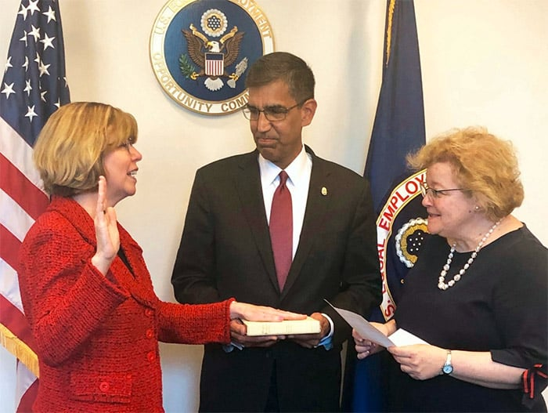
EEOC/FCHR– 500
She was sworn in on May 15 2019 as Chair of the EEOC

Slide 35
Answer
Who is
Janet Dhillon ?

Slide 36
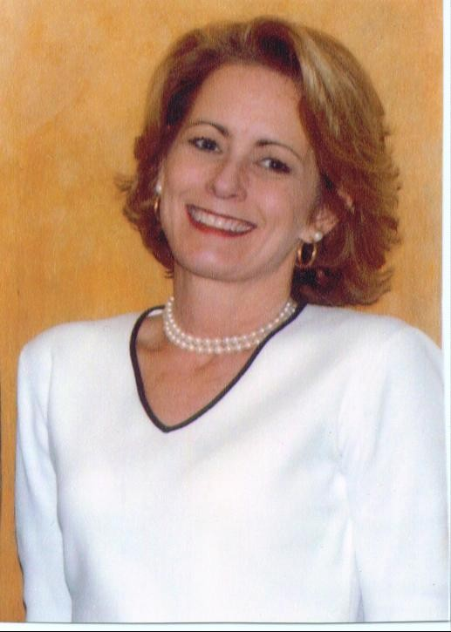
In The News – 100

Slide 37
Answer
Who are
Donna Maggert Poole
James Bax
Curt Kiser ?
PERC Commissioners

Slide 38
In The News – 200
These agreements between employers and employees are getting a lot of attention at the SCOTUS and are an alternate form of dispute resolution.

Slide 39
Answer
What are arbitration agreements?

Slide 40
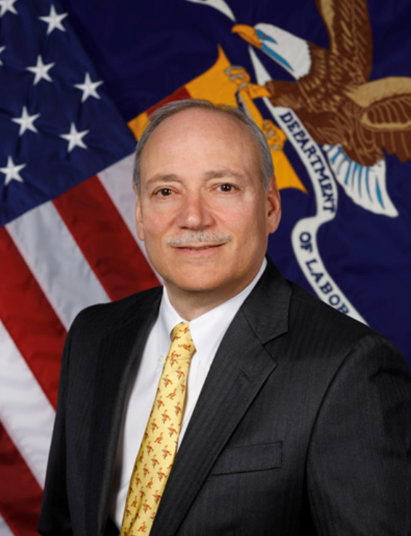
In The News – 300

Slide 41
Answer
Who Is
Patrick Pizella,
Acting Secretary of Labor?

Slide 42
In the News – 400
A union’s ability to collect money from employees to pay for things such as negotiating a contract and representing employees in grievances and arbitrations, and lobbying activities to foster collective bargaining negotiations or secure advocates.

Slide 43
Answer
What is an “agency fee”?

Slide 44
In the News – 500
This 2018 SCOTUS decision
held it is unconstitutional to force workers who are not members of unions to pay “fair share” fees.

Slide 45
Answer
What is Janus v. American Federation of State, County and Municipal Employees Council 31, No. 16-1466, 2018 WL 3129785
(June 27, 2018) ?

Slide 46
Contract “Terms” – 100
A process which workers, through their bargaining committee, deal as a group to determine wages, hours and other conditions of employment.

Slide 47
Answer
What is Collective Bargaining?

Slide 48
Contract “Terms” – 200
The rights of two or more employees to act in concert to form, join, or assist labor organizations in order to affect their wages, hours or work or working conditions.

Slide 49
Answer
What is “Concerted Activity”?

Slide 50
Contract “Terms” – 300
Withdrawal by a government agency of a union's official recognition as exclusive bargaining representative.

Slide 51
Answer
What is a “Decertification”?

Slide 52
Contract “Terms” – 400
Often referred to as a perfunctory tactic whereby a party only goes through the motions of bargaining.

Slide 53
Answer

Slide 54
DAILY DOUBLE!!!

Slide 55
Contract “Terms” – 500
A union's obligation to represent all people in the bargaining unit as fairly and equally as possible. This requirement applies both in the creation and interpretation of collective bargaining agreements.

Slide 56
Answer

Slide 57
Final Jeopardy
This is the best training conference for public sector employee relations professionals.

Slide 58
Answer
What is the FPHRA’s
2019 Annual Training Conference?

Slide 59
THANK YOU!
Karen M. Morinelli
100 North Tampa Street
Suite 3600
Tampa, FL 33602
Karen.morinelli@ODNSS.com
Employers and Lawyers,Working Together

